Slide 1
A model to link them all IFLA-LRM as a driver for harmonization of cataloguing standards related to serials and other continuing resources
Gordon Dunsire
Chair
RDA Steering Committee
Session 074: Impact of recently approved IFLA standards – Committee on Standards
IFLA World Library and Information Congress
Kuala Lumpur, August 25th, 2018
Clement Oury
Head of Data, Network and Standards Department
ISSN International Centre

Slide 2
Program
Stakeholders
Serials
Solutions

Slide 3
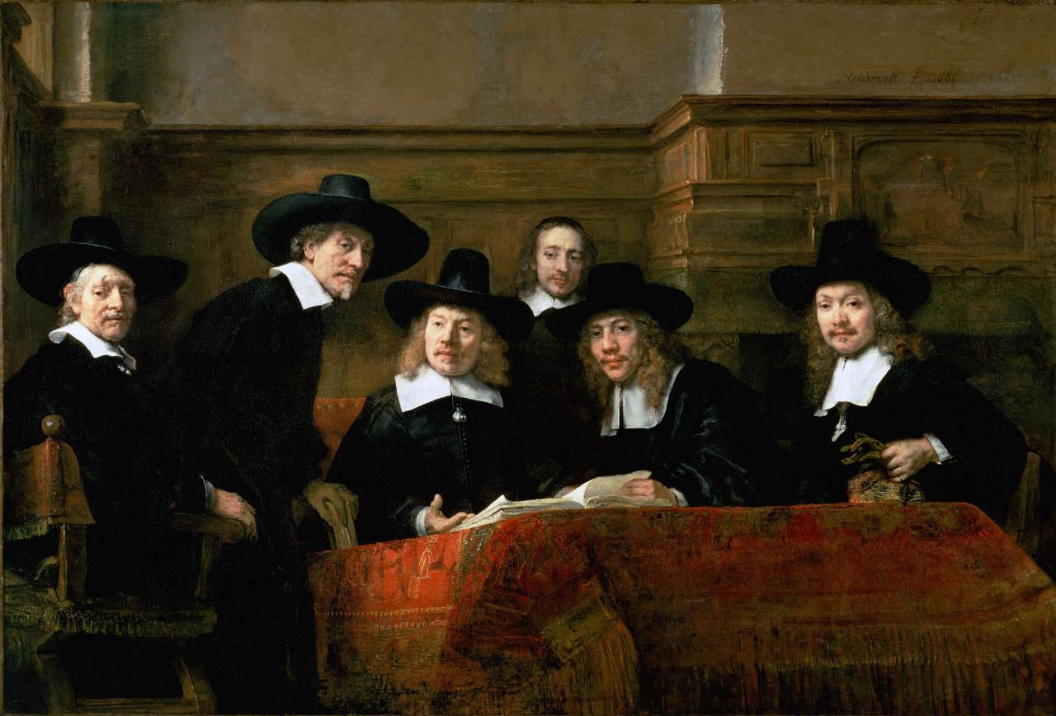
Stakeholders
https://fr.wikipedia.org/wiki/Rembrandt#/media/File:Rembrandt_-_De_Staalmeesters_-_The_Syndics_of_the_Clothmaker%27s_Guild.jpg
Notes:
Source: https://fr.wikipedia.org/wiki/Rembrandt#/media/File:Rembrandt_-_De_Staalmeesters_-_The_Syndics_of_the_Clothmaker%27s_Guild.jpg

Slide 4
RDA
Resource Description and Access
Elements, guidelines, instructions for recording metadata
Strategic goals
Internationalization (beyond the Anglo-American community)
Resources in library and related heritage collections
Linked open data and the Semantic Web
Adoption around the world
Translation into multiple languages

Slide 5
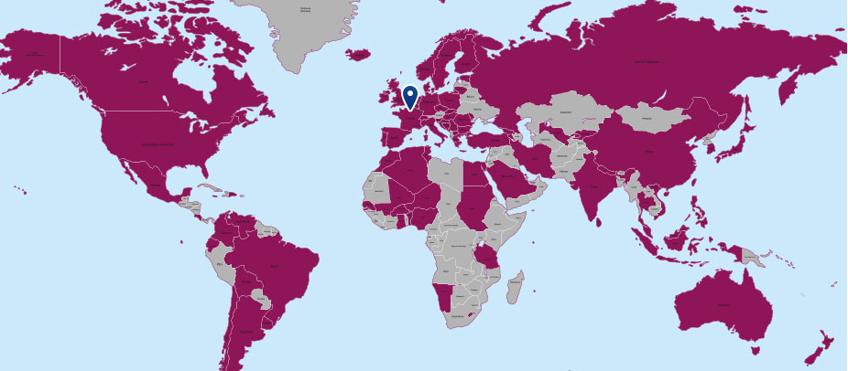
The ISBD and the ISSN Manual
The International Standard Bibliographic Description (ISBD)
Maintained by IFLA
Freely accessible and easy to use
Focused on the pre-FRBR notion of “resource”
The ISSN Network and Manual
International network of 90 National Centres + International Centre (Paris)
Assignment of a unique identifier to continuing resources, production of a bibliographic record
All record ingested in the ISSN Register (https://portal.issn.org/)
Records follow the rules expressed in the ISSN Manual, aligned on the ISBD

Slide 6
A need for harmonization
https://upload.wikimedia.org/wikipedia/commons/2/22/M%C3%A8tre-%C3%A9talon_Paris.JPG
Conflicts or discrepancies between RDA, ISBD and ISSN
Notion of “continuing resource” essential in ISBD/ISSN… but does not even exist in RDA
Case and conditions when a new description should be created
IFLA-LRM as a “yardstick” for all cataloguing standards
As they should be ultimately aligned on IFLA-LRM
Concrete implementation of IFLA-LRM should be commonly discussed
Existence of long-standing relationships
Protocols between RSC and ISSN (2015) and ISBD (2016)
Frequent meetings e.g. in IFLA WLIC at Wrocław (August 2017)
Notes:
Source: https://upload.wikimedia.org/wikipedia/commons/2/22/M%C3%A8tre-%C3%A9talon_Paris.JPG

Slide 7
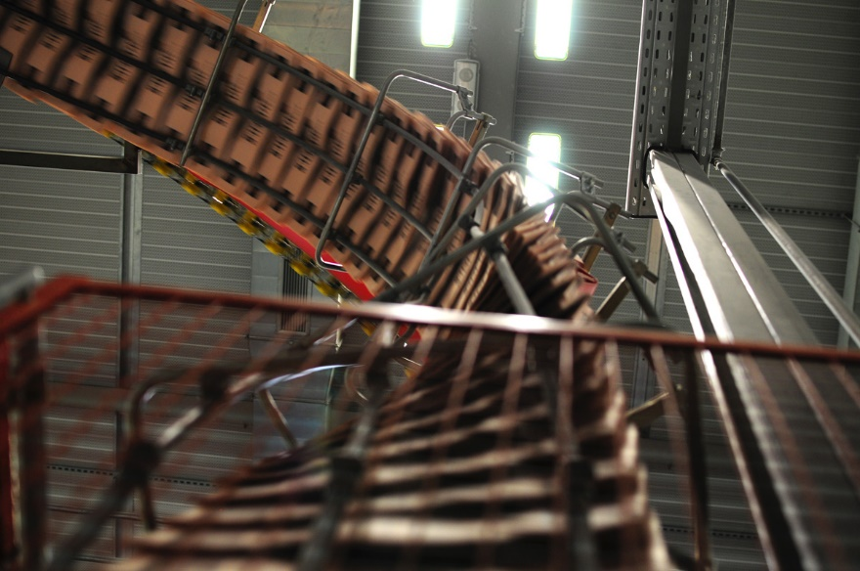
Serials
https://www.flickr.com/photos/goodwines/5181401923/
Notes:
Source: https://www.flickr.com/photos/goodwines/5181401923/

Slide 8
IFLA-LRM alignment for serials and other continuing resources
LRM section 5.8 dedicated to serials
but may be applicable to all continuing resources
Main characteristics underlined:
Aggregate several levels of content (serial title / issue / article)
Dynamic resources whose content change over time
“Description of serial works does not limit itself to a description of the past, but is also intended to allow end-users to make assumptions about what the behavior of a serial work will be, at least in the near future”
IFLA-LRM

Slide 9
IFLA-LRM alignment for serials and other continuing resources
A concrete consequence: the “WEMlock”
1 work =
1 expression =
1 manifestation
OR
1 new manifestation =>
1 new expression
1 new work
LRM section 5.8 dedicated to serials
but may be applicable to all continuing resources
Main characteristics underlined:
Aggregate several levels of content (serial title / issue / article)
Dynamic resources whose content change over time
“Description of serial works does not limit itself to a description of the past, but is also intended to allow end-users to make assumptions about what the behavior of a serial work will be, at least in the near future”
IFLA-LRM

Slide 10
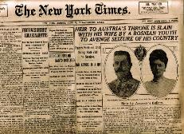
Collocation of serials
The New York times
Work
The New York times (English)
Expression
Manifestation
Notes:
Credits: https://blog.sqlauthority.com/2010/05/17/sqlauthority-news-bookmark-deprecated-database-engine-features-in-sql-server-2008/

Slide 11
The end of collocation for serials?
The New York times (print)
The New York times (CD-Rom)
The New York times (online)
Work
The New York times (print)
The New York times (CD-Rom)
The New York times (online)
Expression
Manifestation

Slide 12
Solutions (?)
https://www.flickr.com/photos/117994717@N06/26222024706/
Notes:
Source: https://www.flickr.com/photos/117994717@N06/26222024706/in/photolist-34Q2JF-devwGC-8B4TFE-fgK6dM-FX9Jof

Slide 13
A Serials Task Force
RSC Aggregates Working Group established in 2015
In charge of modelling aggregates and producing draft instructions for RDA
Objectives and scope
Review the LRM and PRESSoo models and instructions and check their application to serials (and more generally to continuing resources)
Identify potential issues and gaps
Builds on a RSC / ISSN IC discussion paper (http://www.rda-rsc.org/sites/all/files/RSC-Chair-20.pdf)
Members from
RSC: Deborah Fritz (AWG chair), Gordon Dunsire (RSC chair)
CONSER: Ed Jones (STF chair), Les Hawkins
ISSN: Regina Reynolds, Clément Oury
Deliverables
A set of recommendations for the RDA Steering Committee
Concrete influence on the beta version of the new RDA toolkit

Slide 14
Impacts on the RDA Toolkit 1/2
Introducing the notion of “diachronic work”
A work that is planned to be embodied over time
published over a limited time (“finite”) or over an indefinite time (“continuing”)
The “extension plan” is an essential characteristic of the work
While the “mode of issuance” is a manifestation attribute (= number of carriers)
Re-locating several elements from manifestation to work
Frequency – which is part of the “publication plan”
ISSN and key-title: identifier for the work (but also for expression and manifestation)

Slide 15
Impacts on the RDA Toolkit : grouping 2/2
Any RDA entity can be grouped with other entities sharing common characteristics
on any criterion
at the discretion of an implementing agency
To create the group, the implementing agency assigns the same nomen-string to each member of a group
An entity can be a member of more than one group
e.g., the [1] print version of a television program guide for the [2] greater Ottawa region aimed at [3] French-speaking viewers

Slide 16
Group of works: the ISSN-L case
Group identifier: “0362-4331”
Grouping criterion: “same title on different media versions”
Implementing agency: “ISSN International Centre”
ISSN-L 0362-4331
Print 0362-4331
CD 1542-667X
Online 1553-8095

Slide 17
Conclusions
An interesting example of cooperation between different communities
Demonstrated the key-role of LRM to foster harmonization between diverging standards
A work in progress
New RDA version still in beta form
Should influence the upcoming revision of the ISBD, and consequently of the ISSN Manual
Will help ensuring interoperability between the different standards
And consequently, the exchange and distribution of information in the web of data

Slide 18
Thank you for your attention!
https://upload.wikimedia.org/wikipedia/commons/a/ad/Astronomical_Clock%2C_Prague.jpg
Notes:
Source: https://upload.wikimedia.org/wikipedia/commons/a/ad/Astronomical_Clock%2C_Prague.jpg

