Slide 1
RDA and MARC 21
The impact of the 3R Project
Gordon Dunsire, James Hennelly, Thurstan Young
Presented at “RDA and MARC 21”
June 25, 2018, New Orleans, USA

Slide 2
RDA and data encoding
The impact of the 3R Project
Gordon Dunsire, Chair, RSC

Slide 3
3R Project
RDA Toolkit Restructure and Redesign Project
New responsive design and structure
Impact of the IFLA Library Reference Model (LRM)
RDA strategy for international, cultural heritage, and linked data communities

Slide 4
Beta Toolkit
Beta version of the new RDA Toolkit released June 13, 2018
Transformation of guidance and instructions is ongoing; expected completion December 2018
Development of entities, elements, and terminologies almost complete

Slide 5
LRM entities
New entities for Agent, Collective Agent, Nomen, Place, Timespan
Many attributes become relationships
Example: date of birth [of Person]
=> Related timespan of person
More inverse relationships
Date of birth of [related person of timespan]

Slide 6
The numbers
13 entities
1700+ elements
Work | 388 |  | Agent | 175
Expression | 291 |  | Person | 85
Manifestation | 282 |  | Collective Agent | 34
Item | 70 |  | Corporate Body | 84
Place | 45 |  | Family | 46
Timespan | 54 |  | Nomen | 169
RDA Entity | 27

Slide 7
RDA entities
No change for Work, Expression, Manifestation, Place
Item always exemplifies a manifestation
RDA Corporate Body and Family are types of Collective Agent
Person restricted to human beings
Does not cover “non-human personages”

Slide 8
Kinds of recorded data
RDA is designed to support a wide range of data carrier architectures for storage and display
Flat-file: card and other print-based catalogues
Local
(Closed-world)
Bib/Authority: MARC, etc.
RDBMS: Table for each entity, row keys (IDs)
Global (Open-world)
RDF: Classes, properties, and IRIs

Slide 9
Recording methods
Latent in current instructions
Explicit in the new Toolkit
Cover the basic kinds of data recording
Accommodate data from outside the professional cataloguing environment
The metadata deluge
Provide choices to suit applications and costs

Slide 10
Unstructured description

Slide 11
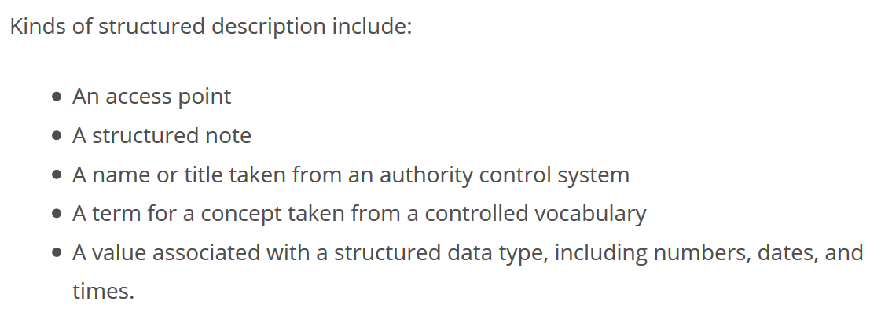
Structured description

Slide 12
Identifier

Slide 13
[Linked data] IRI

Slide 14
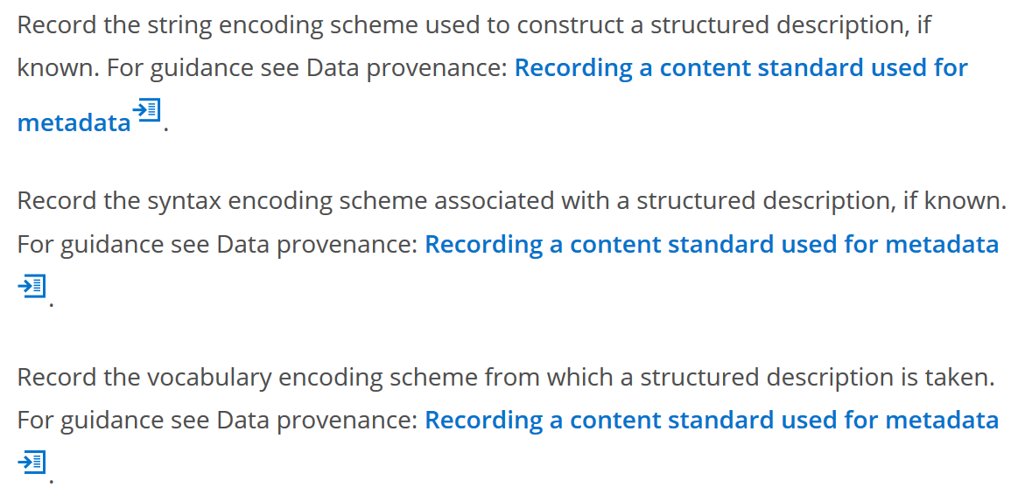
Data provenance

Slide 15
RDA in RDF
RDA uses RDF to record data for RDA Reference (entities, elements, and vocabulary encoding schemes)
Provides data for RDA Toolkit (Glossary, element reference, navigation)
Available from RDA Registry under open license

Slide 16
Recording methods for related data
"note on related entity 2"
Keyword index
"access point for related entity 2"
Authority file
RDA Entity
1
is related to
Standard identifier system
"identifier for related entity 2"
RDA Entity
2
Semantic Web
Notes:
This diagram shows all four recording methods in use to reference a related entity.
The diagram can be interpreted as an RDF graph for linked data, or as a relational schema for a local database.

Slide 17
MARC 21 in RDA Toolkit
James Hennelly, Director, ALA Digital Reference

Slide 18
Map input form
Registry RDF
Input fields
Output mapping
Spreadsheet/csv file
Better than a wordprocessor …

Slide 19
Strings
No MARC 21 in RDF to link to
No thing
String
rdaa:P50001 rdakit:hasM21 "MARC 21 Authority 100 $a" .
Subject
(thing)
Predicate
(thing)
Object
(string)

Slide 20
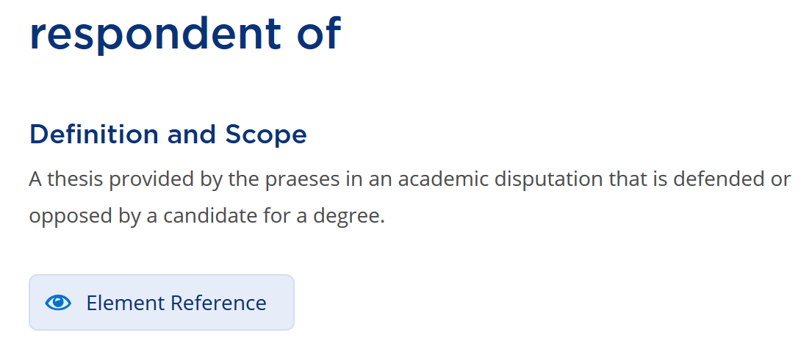
Toolkit display

Slide 21
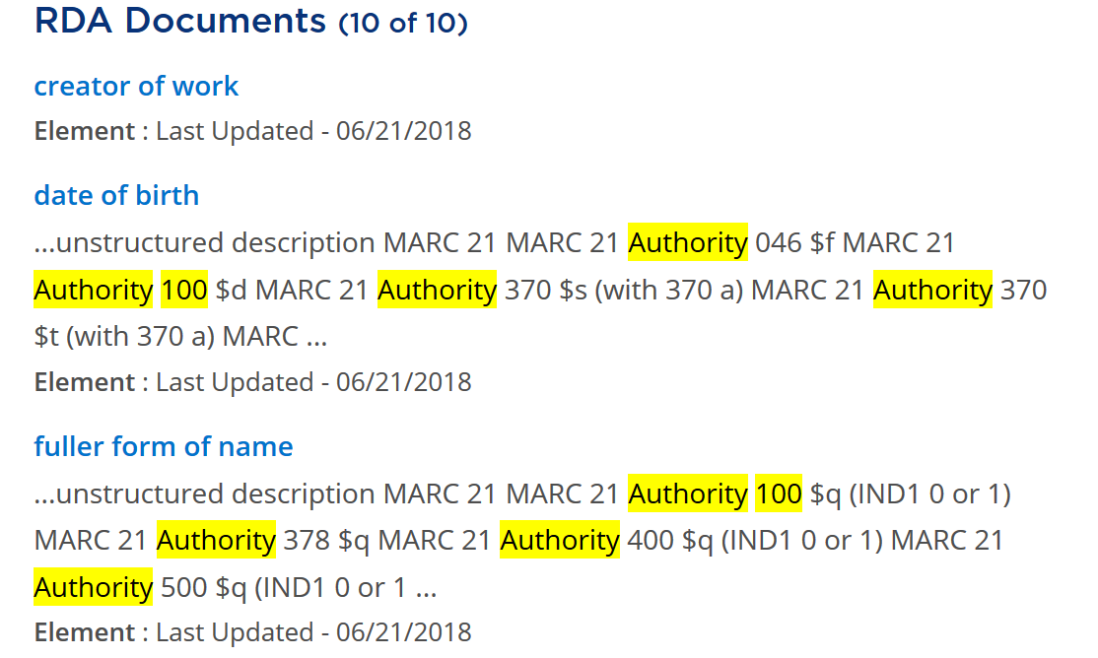
Search: authority 100
First 3 of 10 found

Slide 22
RDA in MARC 21: Accommodating 3R A presentation by Thurstan Young, U.K. Representative to the MARC Advisory Committee
Notes:
This presentation represents a first pass at addressing the potential implications for MARC 21 development arising from 3R. It neither claims to be fully comprehensive in detail nor all encompassing in scope. Its purpose is to generate discussion with regard to what some of the 3R impacts on MARC 21 could be and how any resulting changes might be accomplished.

Slide 23
Context for change (RDA)
3R Project Timeline
New RDA Entities
New RDA Guidance

Slide 24
Context for change (MARC 21)
Existing MARC 21 content designation
New MARC21 content designation
Emerging non-MARC data formats

Slide 25
Basic Principles
Choice of MARC 21 format: bibliographic, authority, other?
Granularity: record; field; subfield level?
Consistency: equivalent field by field content designation?
Utility: is change helpful?
Feasibility: is change possible within format constraints?

Slide 26
3R Project Timeline (13th June deliverables)
An initial implementation of LRM
Reorganized RDA instructions
Redesigned Personal and Institutional Profile capabilities
Search and navigation functions
Cross-Reference and Cross-Reference Preview functions
Ready Reference feature for each RDA element

Slide 27
3R Project Timeline (post 13th June)
Revisions to the RDA standard
Introduction of a graphical browse tool
Translations of the RDA standard
Introduction of policy statements and integrated display
Notes:
After 13th June, additional releases in support of 3R are likely to occur in September and December 2018 as well as February 2019. Revisions to the RDA standard will include refinements to the element set. Until the element set is stable a comprehensive picture of 3R’s potential impacts on MARC 21 development will not emerge. However, sufficient information is already available to make a start on considering its effects.

Slide 28
New RDA Entities
RDA Entity
Nomen
Place
Timespan

Slide 29
New Entities : RDA Entity
RDA Entity : “An abstract class of key conceptual objects in the universe of human discourse that is a focus of interest to users of RDA metadata in library information systems. An RDA entity includes an agent, collective agent, corporate body, expression, family, item, manifestation, nomen, person, place, timespan, and work.”

Slide 30
RDA Entity: Content designation
No content designation present in MARC 21
Accommodation seems unnecessary since it’s function is to support high-level semantics in the RDA/LRM ontology
Notes:
The MARC 21 format introductions define content designation as: “the codes and conventions established explicitly to identify and further characterize the data elements within a record and to support the manipulation of that data.”
http://www.loc.gov/marc/authority/adintro.html

Slide 31
New Entities : Nomen
Nomen : “A designation that refers to an RDA entity. A designation includes a name, title, access point, identifier, and subject classification codes and headings.”

Slide 32
Nomen: Content designation
No content designation present in MARC 21
New content designation would be necessary to separate names and identifiers for those names from the entities which they identify
In principle, each form of name and identifier for that name would require a separate record and unique identifier and its own attributes, such as provenance, could be recorded. In a MARC context, an authority record has to have a unique identifier, but the RCN could not be an identifier for the name
In practice accommodation may be too disruptive to the structure of current authority files

Slide 33
Nomen: Possible implementation scenarios
Split authorities into two separate records : one for names and identifiers and another for attributes of the entity
Split authorities into separate records for each authorized name, variant name, identifier and for attributes of the entity

Slide 34
New Entities : Place
Place : “A given extent of space.”

Slide 35
New Entities : Place (Authority Format)
Existing MARC 21 content designation :
X51 (Geographic Name)
370 (Associated Place)
371 (Address)
X00 / X10 / X11 / X30 / X47 / X48 / X50 / X51 / X55 / X80 / X81 / X82 / X85 $z (Geographic Subdivision)
X10 / X11 $c (Location of meeting)
643 $a (Place)
Notes:
Here are some common elements containing place information in the MARC 21 authority format.

Slide 36
New Entities : Place (Bibliographic Format)
Existing MARC 21 content designation :
008/15-17 (Place of publication, production, or execution)
033 (Date/Time and Place of an Event)
370 (Associated Place)
518 (Date/Time and Place of an Event Note)
651 (Subject Added Entry - Geographic Name)
751 (Added Entry – Geographic Name)
752 (Added Entry - Hierarchical Place Name)
260 / 264 $a (Place of publication, distribution, etc.)
X10 / X11 $c (Location of meeting)
6XX $z (Geographic subdivision)
Notes:
Here are some common elements containing place information in the MARC 21 bibliographic format.

Slide 37
New Entities : Timespan
Timespan : “A temporal extent having a beginning, an end and a duration.”

Slide 38
New Entities : Timespan (Authority Format)
Existing MARC 21 content designation :
X48 (Chronological Term)
046 (Special Coded Dates)
X00 / X10 / X11 / X30 / X47 / X48 / X50 / X51 / X55 / X80 / X81 / X82 / X85 $y (Chronological Subdivision)
X00 $d (Dates associated with name)
X10 / X11 $d (Date of meeting or treaty signing)
X30 $d (Date of treaty signing)
X47 $d (Date of named event)
X00 / X10 / X11 / X30 $f (Date of a work)
Notes:
Here are some common elements containing place information in the MARC 21 authority format.

Slide 39
New Entities : Timespan (Bibliographic Format)
Existing MARC 21 content designation:
033 (Date/Time and Place of an Event)
046 (Special coded dates)
518 (Date/Time and Place of an Event Note)
651 (Subject Added Entry - Geographic Name)
X00 $d (Dates associated with a name)
X10 / X11 $d (Date of meeting or treaty signing)
243 / X30 $d (Date of treaty signing)
647 $d (Date of named event)
X00 / X10 / X11 / X30 / 243 $f (Date of a work)
260 / 264 $c (Date of publication, distribution, etc.)
6XX $y (Chronological Subdivision)
Notes:
Here are some common elements containing place information in the MARC 21 bibliographic format.

Slide 40
New RDA Guidance
Recording Methods
Manifestation Statements
Representative Expressions
Data Provenance
Diachronic Works

Slide 41
Recording Methods
Unstructured description
Structured description
Identifier
IRI (Internationalized Resource Identifier)

Slide 42
Unstructured description
Recording methods include:
Manifestation statement (New)
Unstructured note
Name or title in direct order, as it appears in sources of information
Uncontrolled term for a concept

Slide 43
Manifestation statements : Guidance
A manifestation may carry information that describes the manifestation itself.
This information is recorded to follow the principle of representation.
A manifestation statement supports the user task identify.
A manifestation statement is recorded only as an unstructured description.

Slide 44
Manifestation statements : Elements
Manifestation copyright statement
Manifestation designation of serial statement
Manifestation dissertation statement
Manifestation distribution statement
Manifestation edition statement
Manifestation frequency statement
Manifestation identifier statement
Manifestation manufacture statement
Manifestation production statement
Manifestation publication statement
Manifestation regional encoding statement
Manifestation series statement
Manifestation title and responsibility statement
Notes:
RSC has identified a number of elements which may be used to record manifestation statements.

Slide 45
Manifestation statements : Example (1)
Sample title page layout:
Archaeological Ceramics:
A Review of Current Research
Edited by
Simona Scarcella
BAR International Series 2193

Slide 46
Manifestation statements : Example (2)
Title page detail:
Archaeological Ceramics:
A Review of Current Research
Edited by
Simona Scarcella
Manifestation title and responsibility statement:
Archaeological ceramics: A Review of Current Research Edited by Simona Scarcella
MARC 21 Title statement:
245 00 $a Archaeological Ceramics : $b A Review of Current Research / $c Edited by Simona Scarcella
Notes:
Note that the example models a recording method in which title information is scanned using a light pen. Therefore, transcription guidelines re capitalization do not apply. The same principle is applied to the slides which follow.

Slide 47
Manifestation statements : Example (3)
Title page detail:
BAR International Series 2193
Manifestation series statement:
BAR International Series 2193
MARC 21 Series statement:
490 0# $a BAR International Series; $v 2193

Slide 48
Manifestation statements : Content designation
No content designation present in MARC 21
Existing content designation too granular
Free text strings broken down into separate sub-elements
Manifestation level data : MARC 21 bibliographic format

Slide 49
Manifestation statements : New content designation options
Indicator / subfield level:
New indicators added to existing 0XX / 2XX / 3XX / 4XX / 5XX fields (e.g. a manifestation title and statement of responsibility statement ; manifestation series statement)
OR
New subfields added to existing 0XX / 2XX / 3XX / 4XX / 5XX fields
Field level:
New 0XX / 2XX / 3XX / 4XX / 5XX fields in bibliographic format (e.g. a title page composed of undifferentiated manifestation statements)
Redefine existing fields to carry manifestation statements and new fields to carry more granular elements.

Slide 50
Manifestation statements : Option 1 (Indicator)
Manifestation title and responsibility statement:
Archaeological Ceramics: A Review of Current Research Edited by Simona Scarcella
MARC 21 Title statement:
245 20 $a Archaeological Ceramics: A Review of Current Research Edited by Simona Scarcella
New 245 1st indicator specifies that subfield $a contains manifestation title and responsibility statement (not only title proper).

Slide 51
Manifestation statements : Option 2 (Subfield)
Manifestation title and responsibility statement:
Archaeological Ceramics: A Review of Current Research Edited by Simona Scarcella
MARC 21 Title statement:
245 00 $m Archaeological Ceramics: A Review of Current Research Edited by Simona Scarcella
New 245 $m specifies that subfield contains manifestation title and responsibility statement.

Slide 52
Manifestation statements : Option 3 (Field)
Manifestation statement:
Archaeological Ceramics: A Review of Current Research Edited by Simona Scarcella BAR International Series 2193
MARC 21 Manifestation statement:
241 00 $a Archaeological Ceramics: A Review of Current Research Edited by Simona Scarcella BAR International Series 2193
New 241 tag specifies that field contains an undifferentiated manifestation statement.

Slide 53
Manifestation statements : Option 4 (Redefinition)
Manifestation statement:
Archaeological Ceramics: A Review of Current Research Edited by Simona Scarcella BAR International Series 2193
MARC 21 Manifestation statement:
241 00 $a Archaeological ceramics : $b a review of current research / $c edited by Simona Scarcella
245 00 $a Archaeological Ceramics: A Review of Current Research Edited by Simona Scarcella BAR International Series 2193
New 241 tag carries elements previously accommodated in 245; 245 tag redefined to contain an undifferentiated manifestation statement.
Notes:
Note that in this example the 241 field models a recording method in which transcription guidelines re capitalization have been applied to title information. The 245 field models a recording method in which title information has been scanned using a light pen; therefore, transcription guidelines re capitalization do not apply.

Slide 54
Manifestation Statements : MARC 21 Indicator / Subfield Change Candidates (1)
RDA Element | MARC Bibliographic
Manifestation copyright statement | 260 264 2nd Ind. 4
Manifestation designation of serial statement | 362
Manifestation dissertation statement | 502
Manifestation distribution statement | 260 264 2nd Ind. 2
Manifestation edition statement | 250

Slide 55
Manifestation Statements : MARC 21 Indicator / Subfield Change Candidates (2)
RDA Element | MARC Bibliographic
Manifestation frequency statement | 310
Manifestation identifier statement | 020 022 024 026 028 030 032 037 074 086 502

Slide 56
Manifestation Statements : MARC 21 Indicator / Subfield Change Candidates (3)
RDA Element | MARC Bibliographic
Manifestation manufacture statement | 260 264 2nd Ind 3
Manifestation production statement | 260 264 2nd Ind 0
Manifestation publication statement | 260 264 2nd Ind 1
Manifestation regional encoding statement | 538
Manifestation series statement | 490
Manifestation title and responsibility statement | 245

Slide 57
Manifestation statements : Utility / Feasibility of Change
New content designation would allow the encoding of whole or partial title page content, etc. using scanned data (e.g. recorded using light pen)
New content designation would allow the exact transcription of statements for early printed resources (e.g. complex publication / distribution and manufacture statements)
Sufficient content designation is still available to record manifestation statements (although not consistently field by field)

Slide 58
Representative Expressions : Guidance
A representative expression provides the values of specific elements used to identify a work and distinguish it from other works.
Any expression can be used as a representative expression.
Notes:
The Library Reference Model specifies that: “There is no requirement to precisely identify an expression or expressions which serves as source for the values of the representative expression attributes, nor does that expression need to be recorded in the case where it is identified” LRM page. 42, (LRM-E2-A2)
https://www.ifla.org/files/assets/cataloguing/frbr-lrm/ifla-lrm-august-2017_rev201712.pdf

Slide 59
Representative Expressions Elements for Works
Aspect ratio of representative expression
Colour content of representative expression
Content type of representative expression
Date of capture of representative expression
Duration of representative expression
Extent of representative expression
Intended audience of representative expression
Key of representative expression
Language of representative expression
Medium of performance of representative expression
Place of capture of representative expression
Projection of cartographic content of representative expression
Scale of representative expression
Script of representative expression
Sound content of representative expression

Slide 60
Representative Expression Elements : Example (1)
Sample Work Record:
Creator of work: Charles Dickens
Preferred title of work: Great expectations
Language of representative expression: English
MARC 21 Authority Record :
075 ## $a Work $2 rdaw*
100 1# $a Dickens, Charles, $d 1812-1870. $t Great expectations
377 ## $a eng
* Note that an 075 $2 source code has yet to be defined for RDA Work properties; here it is modelled on the curie prefix specified in the RDA Registry.
Notes:
Note that here the language of representative expression is recorded as an element in field 377.

Slide 61
Representative Expressions Elements: Example (2)
Sample Work Record :
Creator of work: Wolfgang Amadeus Mozart
Preferred title of work: Divertimenti
Key of representative expression: D major
Thematic index number: K. 251
MARC 21 Authority Record:
075 ## $a Work $2 rdaw
100 1# $a Mozart, Wolfgang Amadeus, 1756-2791. $t Divertimenti, $n K. 251, $r D major
383 ## $c K. 251
384 0# $a D major
Notes:
Note that here the key of representative expression is recorded as an element in field 384 and also as part of the AAP in 100 $r.

Slide 62
Representative Expression Elements : Example (3)
Sample Work Record :
Creator of work: Louise Penny
Preferred title of work: Trick of the light
Language of representative expression: English
Representative expression: Penny, Louise. Trick of the light. 2011
MARC 21 Authority Record :
075 ## $a Work $2 rdaw
100 1# $a Penny, Louise. $t Trick of the light
377 ## $a eng
500 1# $w r $i Representative expression: $a Penny, Louise. $t Trick of the light. $f 2011
Notes:
Note that here the language of representative expression is recorded as an element in field 377 and a relationship to representative expression is recorded in the work record.

Slide 63
Representative Expression Elements : Content designation
No content designation present in MARC 21
Existing content designation for elements that could be use to record representative expression elements would be undifferentiated from their expression element counterparts
Could use existing 075 field to differentiate work and expression authority records, hence make it clear whether 3XX field is for work or expression element (subject to new $2 source code)
Expression level data : MARC 21 authority and bibliographic formats

Slide 64
Representative Expression Elements : New content designation options
Content designation options (indicator / subfield level)
New indicators added to existing 3XX fields in authority format
(e.g. language of representative expression)
New indicators added to existing 0XX / 2XX / 3XX / 5XX fields in bibliographic format
OR
New subfields added to existing 3XX fields in authority format
New subfields added to existing 0XX / 2XX / 3XX / 5XX fields in bibliographic format
Content designation options (field level):
New 3XX fields in authority format (e.g. language of representative expression)

Slide 65
Representative Expression Elements : Option 1 (Indicator)
Sample Work Record :
Creator of work: Charles Dickens
Preferred title of work: Great expectations
Language of representative expression: English
MARC 21 Authority Record :
100 1# $a Dickens, Charles, $d 1812-1870. $t Great expectations
377 1# $a eng
New 377 1st indicator specifies that subfield $a contains code for language of representative expression.

Slide 66
Representative Expression Elements : Option 2 (Subfield)
Sample Work Expression Record :
Creator of work: Charles Dickens
Preferred title of work: Great expectations
Language of representative expression: English
MARC 21 Authority Record :
100 1# $a Dickens, Charles, $d 1812-1870. $t Great expectations
377 ## $x eng
New 377 $x specifies that subfield contains code for language of representative expression.

Slide 67
Representative Expression Elements : Option 3 (Field)
Sample Work Record :
Creator of work: Charles Dickens
Preferred title of work: Great expectations
Language of representative expression: English
MARC 21 Authority Record :
100 1# $a Dickens, Charles, $d 1812-1870. $t Great expectations
317 ## $a eng
New 317 tag specifies that field contains code for language of representative expression.

Slide 68
Representative Expression Elements: MARC 21 Indicator / Subfield Change Candidates (1)
RDA Element | MARC Authority | MARC Bibliographic
Aspect ratio of representative expression |  | 500
Colour content of representative expression |  | 300, 340
Content type of representative expression | 336 | 336
Date of capture of representative expression | 388 | 033/518
Duration of representative expression |  | 306

Slide 69
Representative Expression Elements : MARC 21 Indicator / Subfield Change Candidates (2)
RDA Element | MARC Authority | MARC Bibliographic
Extent of representative expression |  | 300
Intended audience of representative expression | 385 | 385
Key of representative expression | 384 | 384
Language of representative expression | 377 | 377
Medium of performance of representative expression | 382 | 382

Slide 70
Representative Expression Elements: MARC 21 Indicator / Subfield Change Candidates (3)
RDA Element | MARC Authority | MARC Bibliographic
Place of capture of representative expression | 370 | 033/518
Projection of cartographic content of representative expression |  | 255
Scale of representative expression |  | 255
Script of representative expression |  | 546, $6
Sound content of representative expression |  | 300
Notes:
Note that $6 will only apply following the implementation of MARC 21 Update 27 (scheduled for Winter 2018/19);
see also MARC Proposal 2018-05 : https://www.loc.gov/marc/mac/2018/2018-05.html.

Slide 71
Representative Expression Elements : Utility / Feasibility of Changes
New content designation would allow using fields for representative expression elements in work authority records without using 075 to indicate the type of entity.
Accommodating changes in authority format:
advantage that more content designation is still available than in the bibliographic format.
Accommodating changes in bibliographic format : advantage that all pre-existing expression elements are already defined there.

Slide 72
Data provenance : Guidance
Data provenance provides information about the metadata recorded in an element or set of elements. This information can be used to infer the context and quality of the metadata.
The metadata being described by data provenance are treated as a metadata work that consists of a metadata statement or a metadata description set.
A metadata work may be described using any appropriate RDA elements and recording methods.

Slide 73
Data Provenance : Common Requirements
Recording an agent who publishes metadata
Recording an agent who records metadata
Recording a content standard used for metadata
Recording a language of description
Recording a scope for validity of metadata
Recording a script of description
Recording a source of metadata
Recording a timespan for validity of metadata
Recording a timespan when metadata are published
Recording a transcription standard used for metadata
Notes:
RSC has identified a number of common requirements for recording data provenance.

Slide 74
Data Provenance : Example (1)
Sample Data Provenance (Description):
Timespan metadata published: February 23, 1994, 15:10:47
Agent who publishes metadata: British Library
Language of description: English
Agent who records metadata: British Library
Content standard used for metadata: RDA
MARC 21 Authority / Bibliographic Record:
005 19940223151047.0
040 ## $a Uk $b eng $c Uk $e rda

Slide 75
Data Provenance : Example (2)
Sample Data Provenance (Description):
Source of metadata: The Swedish phosphate report / R. Wilson, 1995, title page
MARC 21 Authority Record :
670 ## $a The Swedish phosphate report, 1995: $b title page (R. Wilson)

Slide 76
Data Provenance : Content designation
Partial content designation in MARC 21
Content designation mainly at description level
Content designation absent from field level (excepting cases where $5 is defined)
Content designation absent from subfield level

Slide 77
Data Provenance Coverage in MARC 21 (1)
RDA Element | Record Level | Field Level | Subfield Level
Recording an agent who publishes metadata | 040 $a, $d | $5
Recording an agent who records metadata | 040 $a, $c, $d
Recording a content standard used for metadata | 040 $e
Recording a language of description | 040 $b
Recording a scope for validity of metadata

Slide 78
Data Provenance Coverage in MARC 21 (2)
RDA Element | Record Level | Field Level | Subfield Level
Recording a script of description | LDR/09 066
Recording a source of metadata | 670 (Authority) 500,510 (Bibliographic)
Recording a timespan for validity of metadata
Recording a timespan when metadata are published | 005
Recording a transcription standard used for metadata

Slide 79
Data Provenance : Utility / Feasibility of Changes
New content designation to represent provenance information would support semantic web applications.
Sufficient content designation is still available to record data provenance information in the MARC 21 authority and bibliographic formats at the record level
Insufficient content designation is available at the field and subfield level in the bibliographic format.
Greater scope for content designation may be available at field and subfield level in the authority format.

Slide 80
Diachronic Works : Guidance
A diachronic work is a work that is planned to be embodied over time, rather than as a single “act of publication”. This effectively means that the content of the work changes over time, by being realized in one or more discrete expressions that are embodied in one or more manifestations.
The essence of a diachronic work is the plan for the change of content.

Slide 81
Diachronic Works : Categories of “Plan” (Successive)
Successive determinate plan: “An extension plan for a work that is intended to be realized in multiple distinct expressions that are embodied during a closed timespan.” (e.g. serialized novels, reference works)
Successive indeterminate plan: “An extension plan for a work that is intended to be realized in multiple distinct expressions that are embodied during an open timespan” (e.g. periodicals, newspapers)

Slide 82
Diachronic Works : Categories of “Plan” (Integrating)
Integrating determinate plan: “An extension plan for a work that is intended to be realized in one distinct expression that is embodied during a closed timespan.” (e.g. project wikis, conference websites)
Integrating indeterminate plan: “An extension plan for a work that is intended to be realized in one distinct expression that is embodied during an open timespan.” (e.g. updated standards, wikis)

Slide 83
Static Works
Static plan: “An extension plan for a work intended to be realized in one or more distinct expressions that are all embodied simultaneously.” (e.g. novels, poems)
Not planned to be embodied over time, but rather as a single act of publication.

Slide 84
Diachronic Works: Content designation
No content designation present in MARC 21 formats to record the extension plan for diachronic works.
LDR 07 (bibliographic level) denotes the type of resource being described, but not the extension plan.
As a representation of the publisher’s intent, an extension plan may change over time.

Slide 85
Diachronic Works : Utility / Feasibility of Changes
Recording the extension plan for diachronic works would allow statements to be made regarding the intended timespan of successive and integrating works before their actual termination dates.
Sufficient content designation is still available to record the extension plan for diachronic and static works as a set of coded values or controlled terms in the MARC 21 authority and bibliographic formats at record level.

Slide 86
Emerging Non-MARC Data Formats: Is Changing MARC 21 Necessary?
MARC standard now over 50 years old
Limited scope for additional content designation
Bibframe, Schema.org, etc. offer extensible schema which could accommodate 3R changes
To what extent could / will Bibframe implement LRM?

Slide 87
3R Project Timeline
New RDA Toolkit still in beta phase
Transition to live version not expected until 2019
Old Toolkit to be decommissioned 12 months after new version goes live
1-2 Full MAC cycles to amend MARC
What should be the priorities?
Who will do it?

Slide 88
Implementation of Changes: Options for Collaboration
Re-convene RDA/MARC Working Group?
http://www.rda-jsc.org/archivedsite/rdamarcwg.html
New PCC Task Group?
https://www.loc.gov/aba/pcc/taskgroup/task-groups.htm
Other?

Slide 89
Thank You
Thurstan Young
thurstan.young@bl.uk
James Hennelly
jhennelly@rdatoolkit.org
Gordon Dunsire
gordon@gordondunsire.com

