Slide 1
A Bibliographic Roadmap miscellany Vocabularies in space, time, and nets
Gordon Dunsire
Presented to NISO BibRM Group
20 November 2015

Slide 2
Overview
Multilingual vocabularies: vocabularies in space
Describing change: vocabularies in time
Semantic maps: vocabularies in nets

Slide 3
Types of vocabulary
Vocabulary | Definition* | In scope
Dataset | Set of triples about individuals or things. | No
Value vocabulary | Set of triples about values for use in datasets. | Yes
Element set | Set of triples about properties and classes for use in datasets. | Yes
*http://www.w3.org/2005/Incubator/lld/XGR-lld-vocabdataset-20111025/

Slide 4
Multilingual vocabularies
Vocabularies in space

Slide 5
Multilingual vocabularies
Direct translations of element set (class and property) and value concept labels, definitions, notations, etc.
Use RDF separation of machine-readable identifier (URI) from human-readable (translatable!) data (literal).
One URI + multiple labels in multiple languages
Linking vocabularies developed independently in different languages involves Semantic maps

Slide 6
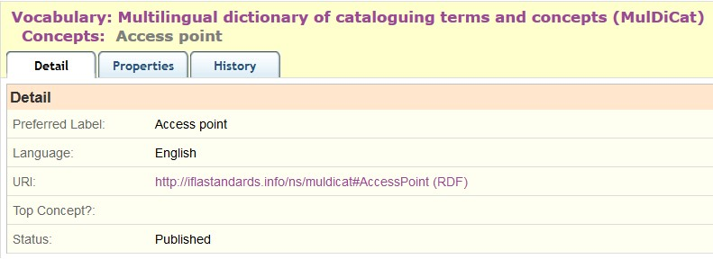
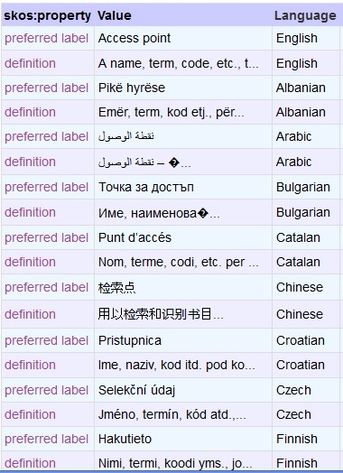
1 URI
25 languages
http://metadataregistry.org/concept/show/id/4675.html

Slide 7
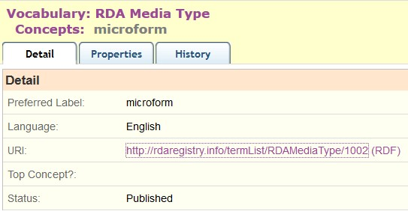
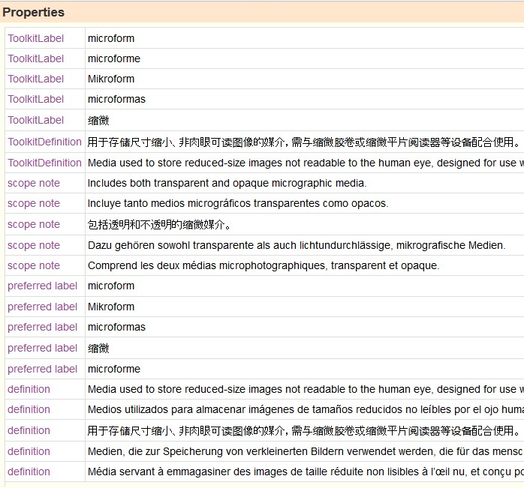

Slide 8
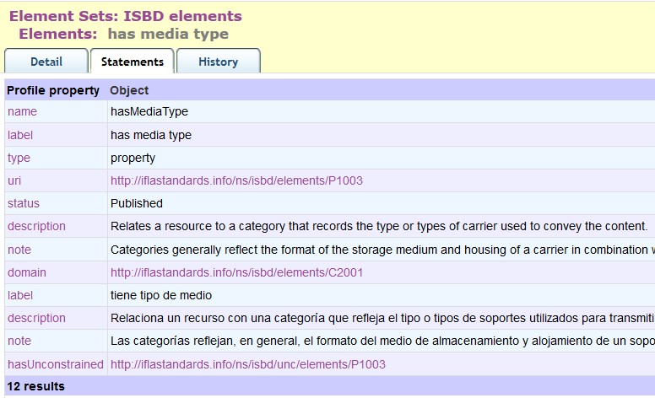
Spanish translation of English property

Slide 9
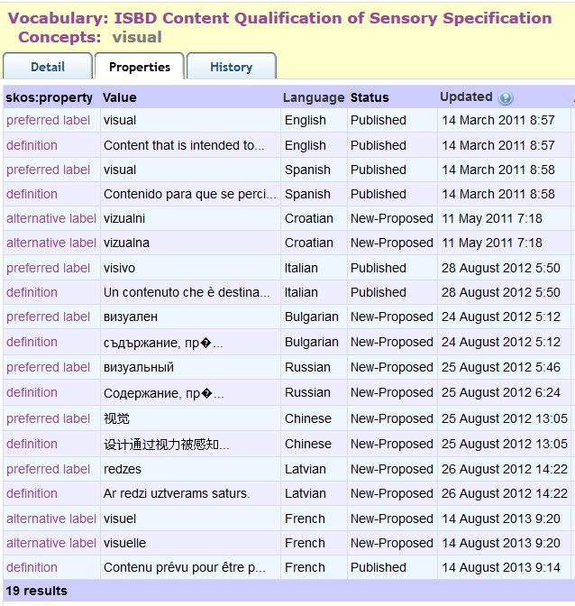
Inflected
Languages
vs
1 x
preference
Avoid
Inflected
Labels
(adjectives)

Slide 10
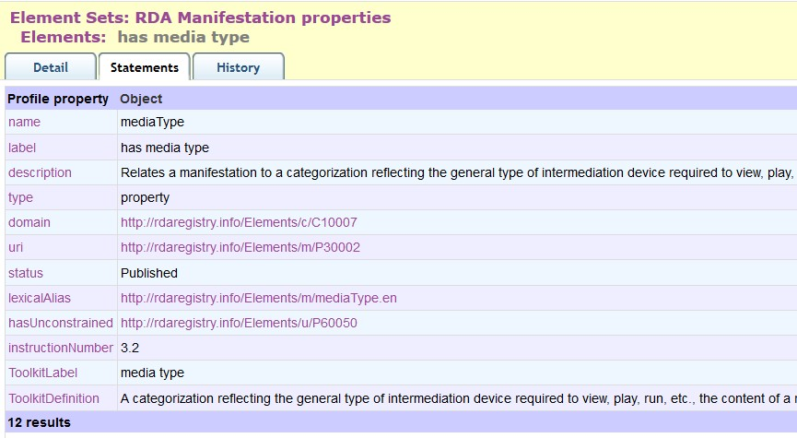
Canonical URI (language-free)
Lexical alias
rdam:typeDeMédia.fr
rdam:medientyp.de
rdam:tipoDeMedio.es

Slide 11
Issues
Linked data structures cannot always be applied consistently across languages
Inflected languages
Subject-predicate-object syntax may not be compatible; e.g. verbalized predicate labels
(is) donor (of)
(has) donor
Translations may not be direct/exact
Conceptual mis-alignment

Slide 12
Describing change
Vocabularies in time

Slide 13
Versioning
Vocabularies change
Additions, deletions, amendments, typos
Linked open data is designed for persistence
Cf Lots of Copies Keep Stuff Safe (LOCKSS)
Lots of out-of-date stuff cannot be removed
Deletion is not helpful; deprecation is
Semantic coherency requires consistency
Semantic versioning helps applications decide

Slide 14
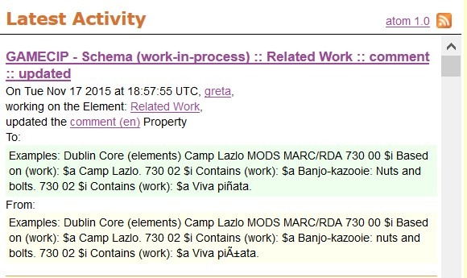
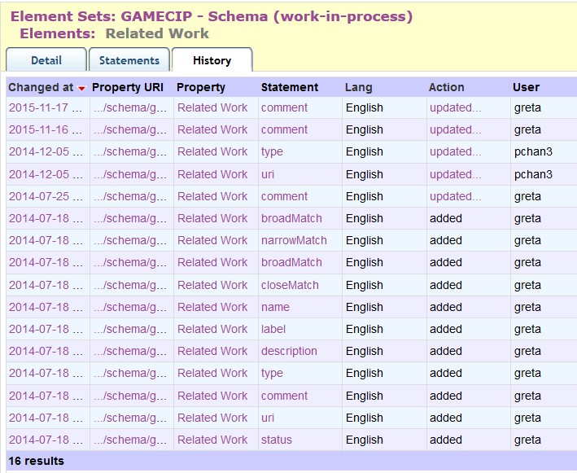
Alert feed
Change
history
(atomic)

Slide 15
Semantic versioning (RDA)
A change that has no effect on the semantics of any Element will result in a 'patch' version that will increment the third segment of the number: "1.1.X"
A change that affects the semantics of any property of any Element will result in a 'minor' version that will increment the second segment "1.X.0", and reset the third segment to 0
A change that breaks backwards semantic compatibility will result in a 'major' version change that increments the first segment "X.0.0", and resets the other segments to 0. We expect major versions to be extremely rare.

Slide 16
GitHub
Version
Control
Roll-back to previous versions allows applications
to synchronize with compatible (semantic) version

Slide 17
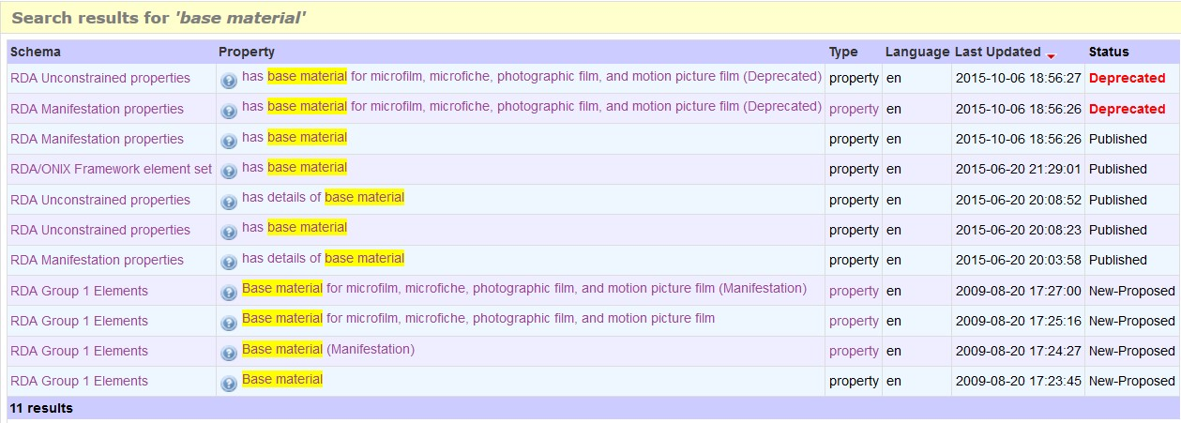
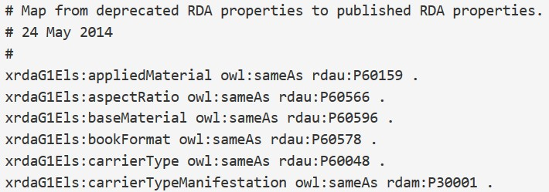
Status keeps track of development
Deprecation
map helps
applications
re-synch

Slide 18
Semantic maps
Vocabularies in nets

Slide 19
Semantic mapping
Links two classes, properties, or concepts
from the same or different namespaces
Equivalence
coarse/dumb
b:
Class
b:
property
b:
concept
sub-class of
sub-property of
narrower of
a:
Class
a:
property
a:
concept
fine/smart

Slide 20
Element sets (schema)
Map of
“Audience”
isbdu:
“has note on use or audience”
Unconstrained
versions
Value vocabularies (KOS)
isbd:
“has note on use or audience”
rdau:
“Intended audience”
rdfs:subPropertyOf
Broader/narrower/same?
dct:
“audience”
m21:
e
BBFC:
18?
“adult”
rdaw:
“Intended audience”
schema:
“audience”
MPAA:
NC-17?
pbcore:
adult
“adult”
m21:
“Target audience”
frbrer:
“has intended audience”
umarc:
m
“adult, general”
m21:
“Target audience of …”
umarc:
k
“adult, serious”
Notes:
Semantic mapping allows dataset triples that use specific element sets and value vocabularies to automatically generate triples using elements and values from other vocabularies at the same or broader level of granularity.
In this example, elements for the relationship “audience”, between a library resource and its intended level of user, are taken from different published schema, including MARC 21, FRBR, RDA, Dublin Core, and ISBD. They can be related using a single, simple, machine-readable ontology property, rdfs:subPropertyOf, that relates an element to a broader element.
Data can be transferred automatically along the direction of the relationship arrow, from finer to broader meaning. This is known as “dumbing-down”: the data loses specificity at each stage and becomes less “smart” in its semantics.
Data cannot be “smartened-up” automatically: machines are dumb, and cannot get something for nothing, information-wise.
Many of the “audience” elements have associated value vocabularies. These can also be linked using semantic mappings, but a human is required to determine the semantics of each value, as given in definitions, before choosing the appropriate relationship.

Slide 21
Inference rules: sub-property
ex:
Property1
“has author”@en
ex:“has label”
ex:
“is sub-
property
of”
ex:
Property2
“has creator”@en
ex:“has label”
ex:
“This work”
ex:“has author”
“Gordon Dunsire”
ex:
“This work”
ex:“has creator”
“Gordon Dunsire”

Slide 22
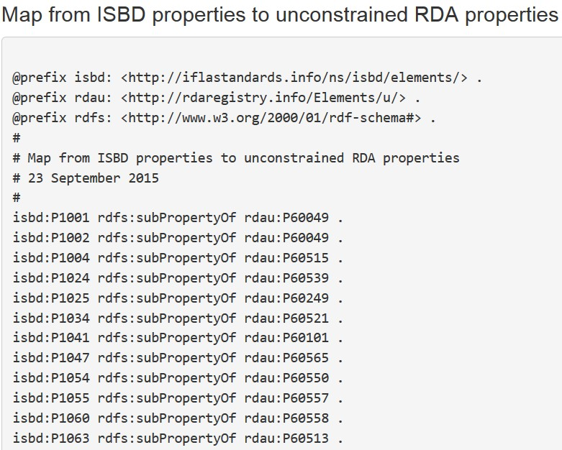
Unconstrained properties
Remove semantics
of (dumb-down)
specific classes
[Linked data cloud, not RDF graph]
Unconstrained
(No entity
Specified)
RDAU
ISBDU
RDA
ISBD
Work
Expression
Manifestation
Item
Resource
Notes:
The RDA Registry contains an element set that is not tied to the RDA entities. The “unconstrained” elements parallel the RDA elements but have general definitions, so they can be used by applications that do not require the finer granularity and semantics of RDA and FRBR.
This allows RDA data to interoperate with data from another community. For example, there is an agreed alignment between ISBD (International Standard Bibliographic Description) elements and RDA elements. The alignment is the basis of a set of linked data maps between ISBD and RDA data.
The diagram shows the maps between the RDA and ISBD element sets and their unconstrained versions. The maps preserve semantic coherence by removing the information about RDA’s WEMI entities and ISBD’s Resource entity; the semantic relationship between these entities is not simple and direct.
The diagram is part of the “linked data cloud” of RDF maps, and is not itself an RDF graph. For example, the map between ISBD and the unconstrained RDA elements represented by a single line is an RDF graph, the first part of which is shown.

Slide 23
Discussion
http://www.gordondunsire.com/presentations.htm
http://www.gordondunsire.com/publicationsrecent.htm
https://www.w3.org/community/bpmlod/
Best Practices for Multilingual Linked Open Data
http://www.rdaregistry.info/rgAbout/versions.html
http://www.rdaregistry.info/Maps/

