Slide 1
An introduction to open linked data for librarians
Gordon Dunsire
National Library of Finland, Helsinki
11 December 2012

Slide 2
Overview
Evolution of library linked data
Resource Description Framework and the Semantic Web
Identity management
Schema, mapping, interoperability
Open publishing
Universal Bibliographic Control

Slide 3
In the beginning ...
Lee, T. B.
Cataloguing has a future. - Audio disc
(Spoken word). - Donated by the author.
1. Metadata
... the catalogue card
Notes:
In the beginning was the catalogue card. Well, it was my first encounter with a catalogue.
This is an example of a catalogue card. We know it is a catalogue card rather than any other kind of card because it has a hole at the bottom. The hole serves multiple functions, particularly if a rod is passed through all the holes in a drawer full of cards. This prevents users accidentally or deliberately filing cards out of order; it prevents the cards in the drawer from being accidentally or deliberately spilled out onto the floor; it tells you which way is down.
The text tells you which way is front - for most but not all cards (but that is another story).
The text is metadata – the example is vaguely self-referential. There is not enough metadata to be really useful. For example, there is no indication of where this item is located (although a sign above the catalogue drawers may well say “For audio discs, please ask at the Audiovisual Desk”).
But there is enough metadata to illustrate how catalogues and their contents have, and are, evolving.

Slide 4
From flat-file record ...
Bibliographic description
Name authority
Author:
Lee, T. B.
Name:
Title:
Cataloguing has a future
Biography:
Content type:
Spoken word
...
Carrier type:
Audio disc
Subject authority
Subject:
Metadata
Term:
Provenance:
Donated by the author
Definition:
...
... to relational record
Notes:
The first stage was automation. Here, all the metadata from the card have been stored in a computer file. The metadata are separated out into different attributes (or fields or cells) in a regular way; all records have the same set (or sub-set) of attributes. This structure is implicit in the metadata on the card, where the attributes are indicated by various punctuation devices (such as brackets), but not always identified specifically. This type of file is known as a flat-file record, as all the metadata are stored in a monolithic two-dimensional , or flat, structure.
The flat-file is not an efficient way of storing metadata if there is a lot of repetition of content between records. One area of repetition in library metadata can be found in the names of persons and organizations; a lot of authors write more than one book, and many documents can be produced by organizations in the course of their business. Repetition is minimized by storing a single record, itself also flat-file, containing metadata for the person or organization. The record is linked to the related bibliographic record using a numerical identifier,. In library terminology, the bibliographic description and name authority records are linked via an authority control number
The same approach works for subject descriptors taken from controlled vocabularies. A single subject authority record is linked to many bibliographic descriptions. Note that the control numbers are transparent to humans; instead, he authority headings (name or subject term) are displayed on the fly using the link.
This type of file structure is known as a relational database.

Slide 5
From flat-file description ...
Bibliographic description
Name authority
Author:
Name:
Lee, T. B.
Title:
Cataloguing has a future
Biography:
Work
...
Content type:
Spoken word
Author:
Carrier type:
Audio disc
Subject authority
Subject:
Subject:
Term:
Metadata
Expression
Provenance:
Donated by the author
Definition:
Content type:
Spoken word
...
Manifestation
Item
... to FRBR record
Notes:
This method of storing descriptive metadata separately from authority headings which act as access points for the description began to be implemented in the 1970s, and is used by the majority of automated library catalogues today. But a new approach is being developed based on the Functional Requirements for Bibliographic Records (FRBR) model published in 1998.
FRBR groups descriptive metadata attributes into four component sets connected in a more-or-less hierarchical way. At the lowest level is the Item, containing metadata about a specific copy of a resource. In this example, the provenance note only applies to this copy.
The next grouping of metadata is the Manifestation, which describes the way information is carried by the resource. Metadata include the title taken from the disc label.
The other two groupings are, continuing up the hierarchy, Expression and Work. Expression metadata describe the content of the resource. Work metadata describe the abstract concept behind the resource, including who conceived it and what the subject is.
A Work can have more than one Expression (for example a translation), which can have more than one Manifestation (for example audiocassette and compact disc), which can have more than one Item (copy). This results in duplication, such as two Expressions using the same Work metadata. Applying the same database principles as for authority headings, a FRBR record should be stored in four separate files which are linked via some kind of identifier or control number.

Slide 6
From FRBR record ...
Work
Name authority
Author:
Name:
Lee, T. B.
Subject:
Subject authority
Expression
Content type:
Spoken word
Term:
Metadata
Manifestation
RDA content type
Title:
Cataloguing has a future
Term:
Carrier type:
Audio disc
RDA carrier type
Item
Provenance:
Term:
Donor:
Donated by the author
Amazon/Publisher
Title:
... to extinction!
Notes:
In this example, the Work component of the FRBR record does not contain any metadata content, just the structure in the form of attribute names ,and transparent links to the content of the authority files.
RDA: resource description and access is the successor to the Anglo-American Cataloguing Rules for determining bibliographic record structure and content. It is fully compatible with FRBR. One of its features is widespread use of controlled terms for metadata content. We can apply the same approach as for authority files, and store the controlled terms in their own file, linked to the relevant component of the FRBR record. Content type is one of the RDA attributes using a controlled vocabulary.
The same for carrier type.
The provenance attribute in the Item component record refers to the author and is an implicit duplication of some of the content of the author attribute, which is authority-controlled. We can minimize this duplication by refining the provenance attribute into the more specific donor attribute and isolating the author reference as the content of that attribute. The donor attribute is then linked to the same name authority record as the author attribute.
This just leaves the manifestation title within the FRBR record. But we could link the attribute to a publisher or bookseller file of titles …
And end up with a FRBR record which contains only attribute names and links. The record is reduced to its bare-bones structure, and effectively is extinct.

Slide 7
Where is the record?
Implicit, not explicit
Everywhere and nowhere
A “semantic” Web will allow machines to create the record just-in-time
We will not have to maintain records just-in-case
The user will have control over the presentation
I want to see an archive or library or museum or Amazon or Google or Flickr or ? display
And by avoiding duplication, we can all get on with describing new stuff ...
Notes:
Where has the bibliographic record gone? Its content has been completely disaggregated to multiple records stored elsewhere in the local system or in remote systems. Library of Congress Subject Headings are already available in a format suitable for this approach, known as linked data. The Virtual International Authority File for names is also available as linked data. Linked data is the basis of the Semantic Web.
The bibliographic record is implicit. The attribute names and links are used to assemble an explicit record on demand. The metadata content is efficiently stored and maintained (any change to authority content is immediately reflected in the assembled record). Catalogues do not have to store any of the metadata locally just-in-case a user needs it; the metadata record is presented just-in-time.
Different sets and arrangements of attributes, reflecting practice in various information communities, can be made available for user choice. The method of assembling the displayed record is the same regardless of the particular attributes used, so there is no reason why the metadata cannot be shown in a familiar or useful format.
The current pre-FRBR environment involves huge amounts of duplicated effort with multiple copies of records being maintained separately at the local level. But we all have backlogs of new bibliographic resources to describe.

Slide 8
Semantic Web
“provides a common framework that allows data to be shared and reused across application, enterprise, and community boundaries.“
“a Web of data” – W3C Semantic Web FAQ
Uses machine-readable metadata
Faster! 24/7/365! Global!
Needs a standard machine-processable format
Resource Description Framework (RDF)

Slide 9
RDF
Resource Description Framework
Data format that supports simple, single metadata statements known as triples
Each statement is in 3 parts
Based on description logic
subject-predicate-object statements
Also specifies relationships between things
thing-relationship-thing statements
Can be used for navigating between, or integrating, information from multiple sources
Notes:
Two key technologies of the Semantic Web are Uniform Resource Identifiers and Resource Description Framework.
These are used to make simple, single metadata statements which relate two specific things of interest; these are called “triples” to reflect the three-part structure.

Slide 10
RDF triple
The title of this book is “Cataloguing”
Subject of the statement = Subject: This book
Nature of the statement = Predicate: (has) title
Value of the statement = Object: “Cataloguing”
This book – has title – “Cataloguing”
subject – predicate – object
This presentation – has author – Gordon Dunsire
This seminar – has event place – Helsinki

Slide 11
Identifiers
Need unambiguous way of identifying each part of the triple for efficient machine-processing
Human labels (“This book”, “has title”) no good
Same thing, different labels; different things, same label
Uniform Resource Identifier (URI)
Exploits the utility of the URL
Machine-readable, regular syntax, unambiguous, global

Slide 12
Uniform Resource Identifier
Can be any unique combination of numbers and letters
No intrinsic meaning; it’s just an identifying label
Can look like a URL
http://iflastandards.info/ns/isbd/elements/P1004
But does not lead to a Web page (in principle ...)
RDF requires the subject and predicate of a triple to be URIs
Object can be a URI, or a literal string (“Cataloguing”)

Slide 13
RDF graph
Relationship
Thing
Thing
URI:1
URI:2
Property URI
Subject
Predicate
Object
URI:3
“Literal”
Property URI

Slide 14
Linked RDF triples
Cluster of triples
with same subject
= record
Chain of triples
= linked data
URI:A
URI:1
URI:2
URI:2
“blah”
URI:3
URI:5
“stuff”
URI:C
URI:3
“Literal”
URI:B

Slide 15
RDF graph of
catalogue card
donor
naf:
Person1
“Lee, T. B.”
author
name
ex:
Work1
saf:
Subject1
subject
“metadata”
term
ex:
Expression1
rdacon:
1013
contentType
“spoken word”
term
ex:
Manifestation1
rdacar:
1004
“audio disc”
carrierType
term
ex:
Item1
pub:
Title1
“Cataloguing has a future”
sameAs
title
Notes:
Sets of linked triples can be shown as a “graph” of nodes (blobs) and connectors (lines). Triples are linked by matching the URIs of nodes.
This is the RDF graph of triples derived from the catalogue card example. Note that rectangular nodes contain the data that can be used by humans; everything else is designed for machine processing. These nodes are “literals” rather than URIs, and form terminators of linked data chains because they cannot be matched to other nodes without ambiguity.

Slide 16
The hyperdimensional (Tardis) card
W3C Library
Audio shop
Lee, T. B.
Cataloguing has a future. - Audio disc
(Spoken word). - Donated by the author.
1. Metadata
Spoken word archive
Lee Museum
“TARDIS four port USB hub, for office-bound Time Lords:
Open a time vortex on your desk” – Pocket-lint
Notes:
So the two-dimensional catalogue card has evolved into something with more than two dimensions. How much more is difficult to say; it could be fractal (between two and three, or three and four, dimensions). Time (the fourth dimension) may be a necessary or desirable feature.
The same metadata supports multiple views appropriate for different user and service contexts. There is no reason why one of those views should not be the catalogue card itself.
But the hole has been replaced by information technology and communications devices which also serve to “bring it all together”. Here, the multi-port USB interconnector is a synecdoche for the Semantic Web.
Cataloguers must evolve too, and be prepared to roam far and wide through space/time to create, maintain, and use bibliographic metadata.

Slide 17
Task: To publish local structured metadata as global linked data in the Semantic Web
So that users inside the local environment can benefit from data/information from outside
And users outside the local environment can benefit from data/information from inside

Slide 18
Identifying library metadata
Assign URIs to things of interest
Three types of thing
The things described in catalogues
Books, digital resources, “works”, “manifestations”, etc.
The controlled terms used to describe them
Vocabularies, subject headings, classifications, etc.
The attributes of things, and relationships between things
Metadata schema, record formats, etc.

Slide 19
Assigning URIs
Must be unique at a global Web level
Typically in two parts:
1: unique Web name
Root, base, domain, namespace
Common to all URIs in “namespace”
E.g. http://iflastandards.info/ns/isbd/elements/
Can be abbreviated in data representations
2: unique identifier in local context
Local part
e.g. P1004

Slide 20
Identifying library things
URI local part can be based on record number
One record to one resource
Granularity of resource identity !!!
National bibliography numbers good for national contexts
But different libraries have copies of same thing
Reflected in duplicate records!

Slide 21
De-duplicating library things
Match local records to national records
Usual problems and partial solutions
Need to include authority record things as well as bibliographic record things
E.g. Persons, places, topics, etc.
⇨ Some local things identified by national URIs
⇨ Some local things identified by local URIs

Slide 22
Identifying library terms
Terms used for record attributes
E.g. carrier and content types
URIs often assigned in Simple Knowledge Organization System (SKOS) value vocabularies
Same issues of de-duplication between local and national < international data
Additional multi-lingual and multi-cultural issues at Web scale

Slide 23
Linking URIs
is same as
URI:1
URI:2
Good for things
(hard boundaries)
Good for terms
(fuzzy boundaries)
etc.
has narrower term
has close match
URI:3
URI:4
has exact match

Slide 24
Who creates the links?
Not machines!
That is, not directly …
Librarians?
Other professionals?
End-users?
Machines!
Statistical analysis of associations (large numbers)
Is less than 100 percent “accuracy” acceptable?

Slide 25
Identifying library schema
Schema represented as RDF element set
Entities/tables ⇨ RDF classes
Attributes/fields, relationships ⇨ RDF properties
= predicates
Each class and property has own URI (from namespace)
E.g. dct:BibliographicResource
E.g. rda:carrierType

Slide 26
Standard library element sets
Dublin Core ✓
Functional Requirements for Bibliographic Records (FRBR) ✓
+ Authority Date (FRAD), Subject Authority Date (FRSAD)
International Standard Bibliographic Description (ISBD) ✓
Resource Description and Access (RDA) ✓
UNIMARC [2013/14] ?
MARC 21 [BIBFRAME] ???

Slide 27
Assigning element set URIs
Two scenarios:
Library schema represented in RDF?
Use element set (class and property) URIs
One-to-one ⇨ semantic preservation ⇨ no loss of information
Library schema not represented in RDF?
Create element set for local schema 
Re-use URIs from other element sets …

Slide 28
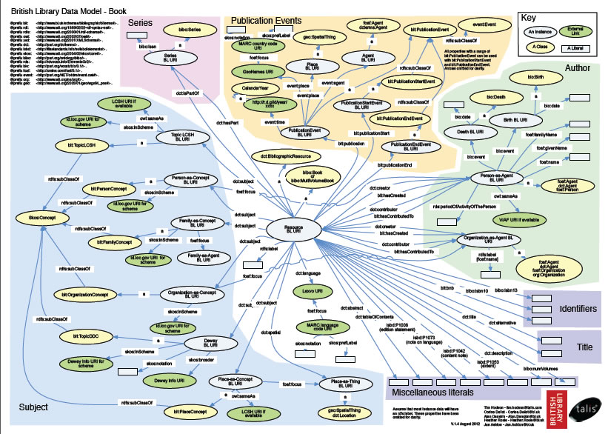
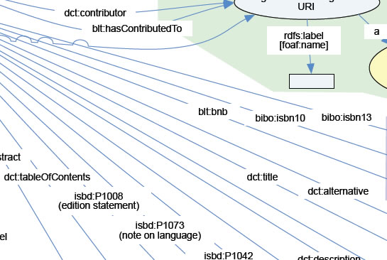
Bibliographic Ontology
Dublin Core
ISBD
Etc.
Mapping from MARC 21 to multiple linked data element sets

Slide 29
Mapping from local schema (MARC 21) to linked data (global) schema can be “lossy”
Some information may be lost, because the local attribute must have the same or narrower meaning as the global property to maintain semantic coherency
Uniform title ⇨ DC title ✓
Uniform title ⇨RDA manifestation title ✗

Slide 30
To avoid losing local information in the global Semantic Web, we should represent the local schema as an RDF element set
British National Bibliography needs an element set for MARC 21
But MARC 21 has “messy” semantics, mixed up with syntax of tags, indicators, and subfields

Slide 31
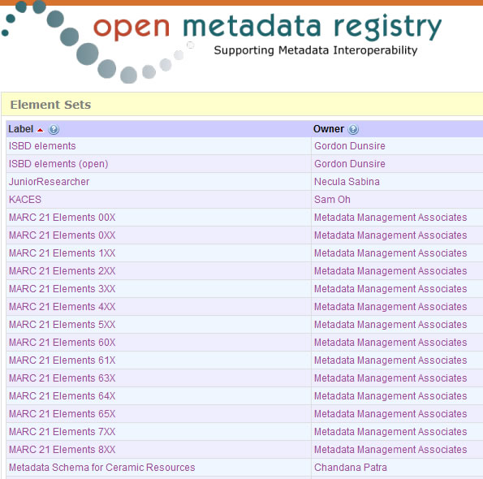
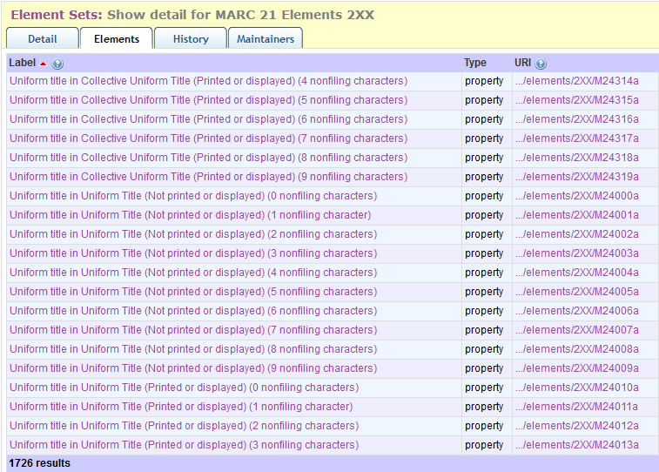
>14000 properties
Not every tag, yet!

Slide 32
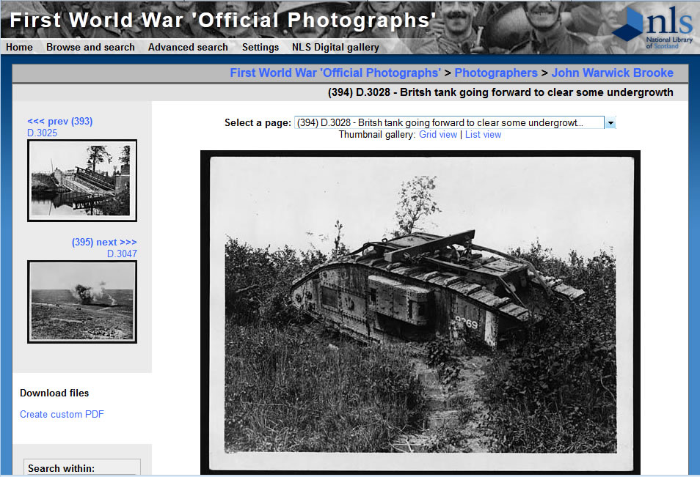
Something less complicated than MARC 21:

Slide 33
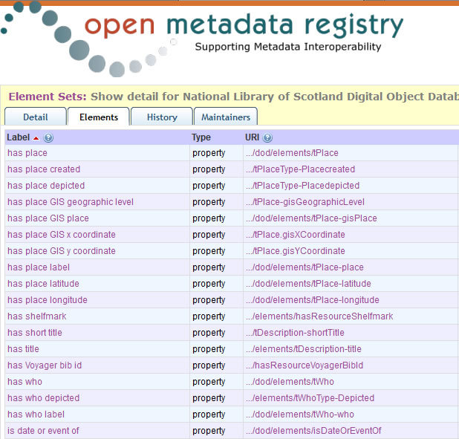
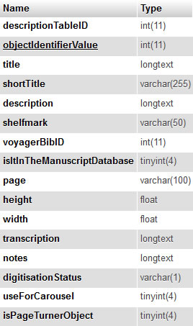

Slide 34
Advantages of local RDF element set
Published linked data loses no information
Other communities can see the semantics and structure of the local data schema
Where the linked data comes from
Other communities can re-use the schema
For their own local data
To map from their own local schema (lossy!)
Element set can still be mapped to other elements
Bibliographic Ontology, Dublin Core, ISBD, etc.
Have your cake, and eat it!

Slide 35
Semantic reasoning: the sub-property ladder
“sub-property of” is an RDF property which links two other properties
Ontological triple:
Property1 sub-property of Property2
Semantic rule:
If P1 sub-property of P2;
And data triple: Resource P1 “stuff”
Then data triple: Resource P2 “stuff”

Slide 36
Sub-property ladder
Ontology
Data triples
dct:title
Resource title “Tank”
rdfs:subPropertyOf
rda:variantTitle
Resource variantTitle “Tank”
rdfs:subPropertyOf
dod:hasShortTitle
Resource hasShortTitle “Tank”

Slide 37
Have your cake and eat it!
[You] Publish your local schema in RDF
[You] Publish your local data triples using local schema
[Anyone] Publish mappings from local schema to other, more global schema
[Anyone] Publish mapped global data triples using “reasoner” software

Slide 38
Shrinking the silo
Data
(RDBMS)
RDF dataset
Schema
(RDBMS)
RDF element set
Mappings
(XML/XSLT)
RDF ontology
Local silo
Open Global Semantic Web

Slide 39
Universal Bibliographic Control
Top-down approach has failed
No longer a core activity of IFLA
Not “one ring to rule them all”
No one-size-fits-all global standards
No matter how “core”, dumb, or encompassing
Virtual International Authority File (VIAF) uses bottom-up approach
Local data; global “focus” or cluster

Slide 40
Ontological mapping & interoperability
Sub-property ladder is a powerful tool for interoperability
But every ladder rung (ontological link) must “dumb-up” and lose conflicting semantics
Property definition broadens with super-property
Property domain/range must super-class with super-property
Or super-property domain/range is blank
= owl:Thing
Need “unconstrained” properties

Slide 41
unc:
“has note on use or audience”
rdfs:
subPropertyOf
isbd:
“has note on use or audience”
unc:
“Intended audience”
rdfs:
subPropertyOf
dct:
“audience”
rda:
“Intended audience”
m21:
“Target audience”
frbrer:
“has intended audience”
rdfs:
subPropertyOf
m21:
“Target audience of …”

Slide 42
“Commons” properties
Unconstrained by domain or range
Broad definition
Common to bibliographic schema
Consensus?
Who creates and maintains?

Slide 43
commons:
“extent”
isbd:
“has specific material designation and extent”
dcterms:
“extent”
rda:
“extent”
marc21:
“Physical description”
frbrer:
“has extent of the expression”
rda:
“extent of text”
bibo:
“numPages”
rda:
“duration”
rda:
“extent of text (Manifestation)”
rda:
“duration (Expression)”

Slide 44
Managing mappings
Duplicate maps
Ontologies
Partial maps
From single mappings up
Semantic collisions
Inconsistencies between maps
Map names
Named graphs

Slide 45
Bibliographic granularity
Aggregate resources: Collections, etc.
Resource vs Work/Expression/Manifestion/Item
Or Work/Instance? [BIBFRAME]
Aggregated statements: e.g. Publication statement
Components: place, publisher, date
Repeatable: need to cluster components
Every granular level needs identification!
Beware of blank nodes …

Slide 46
Materials specified
“2001-2005”
Place of publication,
distribution, etc.
Publication
statement:
1
“Edinburgh :”
Publication,
Distribution, etc. (Imprint)
“Mudhut Publishing”
Name of publisher,
distributor, etc.
ex:
1
Materials specified
“2006”
Publication,
Distribution, etc. (Imprint)
Place of publication,
distribution, etc.
Publication
statement:
2
“Edinburgh :”
“Castle Press”
Name of publisher,
distributor, etc.

Slide 47
Bottom line: trust a librarian?
Provenance is important
Anyone can say Anything about Any thing (AAA)
No intrinsic test of truth – only inconsistency
“Who said that?”
Competing data from many different sources: social networks, publishers and sellers, governments, propagandists, etc.
Library data generally of higher quality
Ethos of trust, neutrality, etc.
Can we keep it that way?
Notes:
Library communities have been developing linked data concepts for much longer than most others; it is nearly 150 years since the start of modern cataloguing with the rules for the British Museum catalogue.
Libraries and librarians have a very high “trust” factor with the general public, and we are in a position to raise the general quality of the Semantic Web by ensuring our metadata is contributed. Library data will be competing with data from the widest range of sources.

Slide 48
Questions?
gordon@gordondunsire.com

