Slide 1
Potential impact of ISBD for Manifestation on the future of UNIMARC
Gordon Dunsire and Mirna Willer
Presented to 6th UNIMARC Users Meeting,
Maribor, Slovenia, 12 November 2024

Slide 2
ISBD for Manifestation
Phase 1 of a project to develop International Standard Bibliographic Description (ISBD) as an implementation of the IFLA Library Reference Model (LRM)
Phase 1 focused on the LRM Manifestation entity
Phase 2 will cover the other LRM entities
Notes:
ISBD for Manifestation is the first phase of a project that will eventually cover all of the LRM entities.

Slide 3
ISBD for single-entity cataloguing
ISBDM developed as a stand-alone content standard
Stipulations only for the description of a manifestation, but take into account the context of the other LRM entities
Elements for manifestation attributes (characteristics)
Elements for relationships between manifestation and other entities
Elements for annotations that refer to other entities
Notes:
The first phase of the project focused on a single LRM entity (Manifestation) in a context of single-entity cataloguing. This has two main advantages:
1. The second phase of the project might not be completed for a variety of reasons, so the output of the first phase will remain useful.
2. Lessons learned in the first phase can be systematically applied to the entities covered in the second phase.
Metadata for other LRM entities that needs to be incorporated in the metadata for Manifestation is accommodated by several devices.
Non-manifestation attributes can be included by using short-cut elements that access controlled values for other entities. The most notable case in ISBDM is the inclusion of an Expression content type in the short-cut element “has category of content”. The short-cut does not distinguish which expression is referenced, but re-uses the value vocabulary for Expression that is likely to be developed in the second phase because it is based on the RDA/ONIX Framework for Resource Categorization.
ISBDM also provides broad relationship elements from Manifestation to the other LRM entities which have similar functionality to authorities.
There are also broad note elements for uncontrolled descriptions of other entities associated with the manifestation being described..

Slide 4
ISBDM elements
4 categories:
Manifestation statements and notes (annotations)
Attributes
Relationships
LRM-E4-A4 Manifestation statement applies to Manifestation only
Other entities have notes, attributes, and relationships
Notes:
ISBDM identifies four categories of element.
This reduces to three categories for all other LRM entities, because the manifestation statement category applies only to Manifestation.
The categories are defined by the values which can be recorded for the element, and how the values are processed for functionality in an information storage and retrieval application.
For example, an attribute element may be processed for keyword indexing in general, and for browsing terms or their translations from a controlled value vocabulary.

Slide 5
ISBDM element hierarchy
Elements are arranged in semantic hierarchies:
has physical characteristic
has material
has base material
Granularity is not as fine as the consolidated ISBD because stipulations are generalized to support a wider scope
Notes:
All ISBDM elements belong to an element hierarchy based on semantics; that is, elements with a broader meaning are placed above elements with a narrower meaning in each hierarchy.
For example, the “has material” element is narrower in meaning than the “has physical characteristic” element and is broader in meaning than the “has bae material” element.
The depth of the hierarchies, which is an indication of granularity, is not as great as the consolidated ISBD because the stipulations have been broadened to support the expanded focus from Manifestation in the consolidated ISBD to all of the LRM entities.

Slide 6
ISBDM name space
Element category | Number of elements
Statements | 8
Notes | 20
Attributes | 37
Relationships | 63
Total | 128
Minimum numbers: more elements will be added during phase 2
Excludes value vocabularies
Uses current IFLA namespace procedures
Notes:
This table gives the number of elements in each category for ISBDM.
The number is likely to increase in the second phase of the project. For example, a relationship element from another entity to Manifestation will generate an inverse element from Manifestation to the other entity. ISBDM in the first phase has relationship elements to other entities only at the broadest level, for example “has person associated with manifestation”.
The table excludes the name space for value vocabularies.
The RDF (linked data) namespace for ISBDM is constructed according to current IFLA guidelines.

Slide 7
ISBDM value space
Statements and notes have 1 category of value
Uncontrolled value
Attributes have 4 categories of value
Uncontrolled value
Controlled term
Notation for controlled term
IRI for controlled term
Relationships have 3 categories of value
Controlled heading (access point) for related entity
Controlled identifier for related entity
IRI for related entity
Notes:
Each ISBDM element accommodates one or more kinds of value.
The value categories are distinguished by the source of the value and how the value is processed for use in an information retrieval system.
For example, the source of an uncontrolled value may be the manifestation itself or a cataloguing agency, and the value can only be indexed by uncontrolled keyword for retrieval. On the other hand, the source of a controlled term, heading, notation, identifier, or IRI is a value vocabulary or authority file that is maintained separately from element, and the value can be indexed for controlled keyword searching or listed for browsing.

Slide 8
Preliminary activity for phase 2
ISBD Review Group recommends a single-entity approach for each entity
Use ISBDM as a template for ISBD for Work, etc.
Coordinate stipulations and guidance via an entity-based menu
Each ‘stand-alone’ component of ISBD for LRM can be applied independently to attract a wider range of communities
ISBDM element set expanded as the basis of an element set for ISBD for LRM
Indicates minimum size of ISBD/LRM namespace
Notes:
The ISBD Review Group recommends adopting the single-entity cataloguing view for each of the other LRM entities.
This allows the ISBDM templates for layout of guidance and stipulations, with associated boilerplate content, to be re-used in the second phase.
ISBDM is developed as an online product, so bringing together the single-entity ISBDs requires just the addition of a higher-level menu.
This approach will allow entity-based ISBDs to be picked and mixed to better support local implementations and applications. This will be attractive to applications that do not need to use all of the LRM entities.
As a scoping study for the second phase, the ISBDM element set has been expanded to cover the other LRM entities by incorporating LRM attributes and relationships and inverses of the Manifestation relationship elements. This provides an indication of the minimum accommodation requirements for the UNIMARC encoding of ISBD for LRM.
The second phase of the project will develop additional elements for finer granularity to interoperate with RDA and accommodate the provisions of the current UNIMARC.

Slide 9
Expanded name space for ISBD/LRM
Entity | Element categories |  |  |  | Total
 | s | n | a | r
Manifestation | 8 | 20 | 37 | 63 | 128
Work |  | 13 | 2 | 44 | 59
Expression |  | 13 | 9 | 30 | 52
Item |  | 13 | 2 | 29 | 41
Agent |  | 13 | 4 | 31 | 48
Collective Agent |  | 13 | 4 | 37 | 54
Person |  | 13 | 5 | 30 | 48
Place |  | 13 | 2 | 27 | 42
Time-span |  | 13 | 1 | 30 | 44
Nomen |  | 13 | 8 | 99 | 120
Notes:
This table shows the results of expanding the scope of ISBD for LRM beyond Manifestation.
Manifestation has the largest number of elements as a result of the granularity developed in the first phase of the project.
Nomen has the largest number of elements beyond ISBDM because of inverses for appellations such as access point and identifier.

Slide 10
Further expansion
Name space(s) are minimums: further expansion is anticipated
Expanded element set is based on ISBDM and LRM, and part of RDA
Additional elements to be determined via:
Phase 2 (especially granularity and RDA)
Matching to UNIMARC A and B
Notes:
As previously noted, the name space numbers are minimums that will increase during the second phase of the project.
The impact of interoperability with RDA will be explored more fully during the second phase. It is unlikely that every RDA element will have a corresponding ISBD for LRM element because ISBD will be more prescriptive than RDA and will not accommodate RDA elements based on the approach of the consolidated ISBD. For example, RDA accommodates both the new manifestation statement elements from LRM and the older ISBD structures of areas that mix annotations and “authority” values. The latter is not supported by ISBDM because the focus of the metadata has shifted radically from “resource” to the LRM entities.

Slide 11
Impact on ‘new’ UNIMARC
UNIMARC for LRM must accommodate ISBD for LRM:
Name space x Value space for category of element
e.g. 1 relationship x 3 kinds of value
Controlled vocabularies (ISBDM has 12)
UNIMARC for LRM should accommodate RDA:
Name space x Value space for each element
Controlled vocabularies (approximately 45)
Some overlap with ISBDM vocabularies
Notes:
UNIMARC encoding of ISBD for Manifestation and the other LRM entities must accommodate the distinct elements in the name spaces and the different kinds of values that can be recorded.
The minimum number of distinct UNIMARC encodings required is calculated by multiplying the number of elements in each category by the number of values that can be recorded for each category.
In addition, UNIMARC must also encoded the terms, notations, and IRIs in each of the ISBD for LRM value vocabularies.
A similar calculation can be made for the UNIMARC encoding of RDA. Each element in RDA is assigned one or more of four recording methods (uncontrolled description, controlled description, identifier, and IRI). The calculation can be based on currently available data from the RDA Registry.
There will be some overlap between ISBD for LRM, RDA, and UNIMARC value vocabularies. It is a moot point if these should be cloned for each standard, or shared between the standards.

Slide 12
Single-entity UNIMARCs (1)
In entity-based cataloguing there are advantages in having a separate UNIMARC encoding for each entity:
Distinction between entities is at the broadest level of the standard itself
Internal UNIMARC indicators or codes not required to distinguish entities
Reduces processing to distinguish entities for storage and retrieval
Notes:
Following the ISBD Review Group’s recommendation that each ISBD for LRM is developed as a standalone, single-entity cataloguing standard, there are advantages for this approach to be adopted for the future development of UNIMARC.
If a UNIMARC is intended to accommodate more than one LRM entity, it will be necessary to indicate to which entity an encoding refers, either by using distinct encodings for each entity or by a broad indicator of which entity is being encoded.
Using distinct encodings for each entity within a single UNIMARC will lose the advantage of mnemonic encoding of the same field or subfield encodings being used for similar elements between the entities. This may be alleviated by using the indicators for each field with fixed values for each entity, but this will require additional processing to extract the metadata in local applications.
For example, an application that uses Manifestation data that is encoded in a specific UNIMARC for Manifestation only has to identify the entity and select the appropriate UNIMARC. Otherwise, the application must process the multiple-entity UNIMARC to identify the Manifestation elements before processing them.

Slide 13
Single-entity UNIMARCs (2)
Encoding mnemonics (field enumeration, indicators, and sub-field codes) can be applied between each UNIMARC for similar elements and value spaces
Applications have a choice of which entity encoding to use for their metadata
E.g. Library of translations can use stand-alone ISBD and UNIMARC for Expression
Notes:
As noted, a single-entity UNIMARC gains the advantages of encoding mnemonics.
For example, the “has category” elements for each LRM entity (such as “has category of manifestation”) can be encoded with the same field and subfield codes across each single-entity UNIMARC.
Also, this approach will follow the ISBD Review Group’s recommendation for single-entity ISBDs and the advantages it brings. In particular, communities and applications that do not require the use of every LRM entity will be able to pick and mix the IFLA content and encoding standards for the entities they choose.

Slide 14
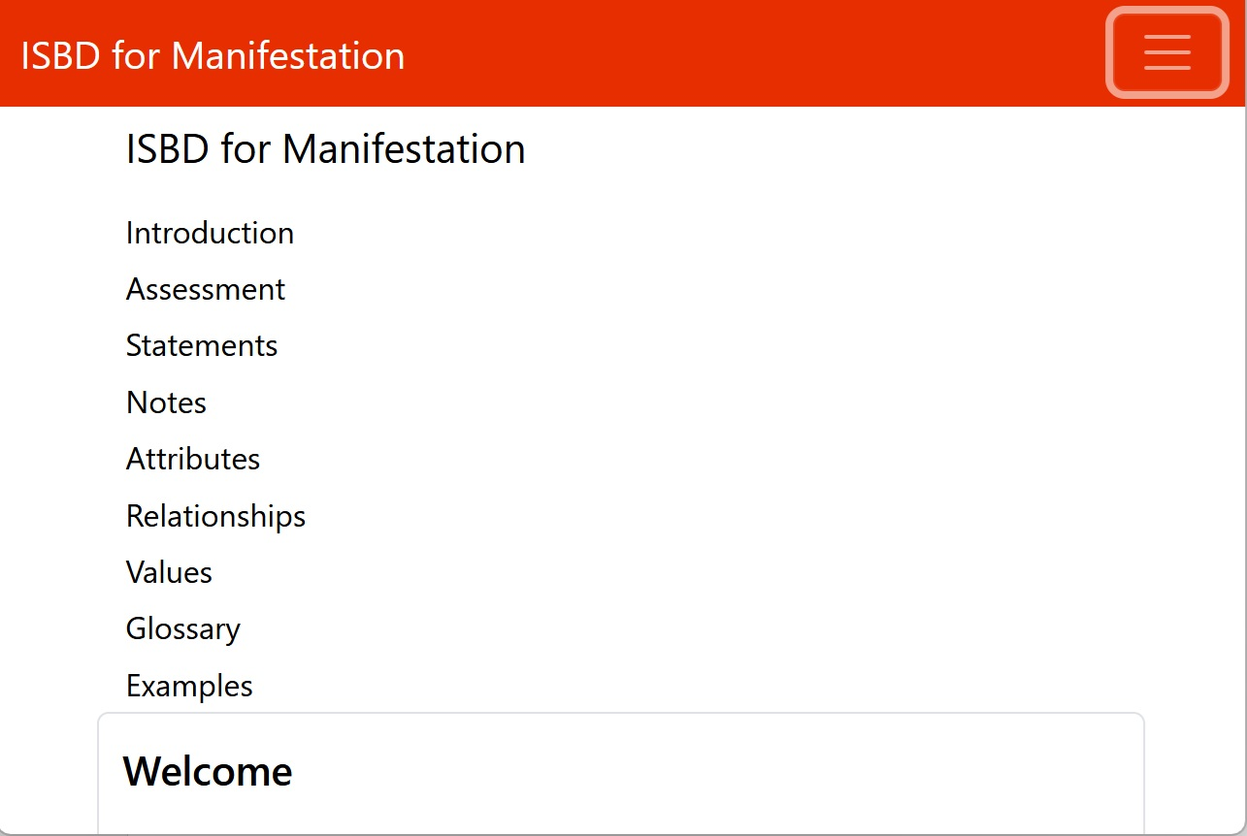
Thank you!
ISBD for Manifestation (draft) is online:
https://www.iflastandards.info/ISBDM/

