Slide 1
RDA from the bottom up: transforming the past into the future of metadata
Gordon Dunsire
Presented at the Second National RDA Cataloging Meeting: Trends and Challenges, National Library of Colombia, 26 October 2023

Slide 2
Overview
Universal bibliographic control in the current (5th) information age
Tools for managing metadata
Significance of the new RDA and metadata

Slide 3
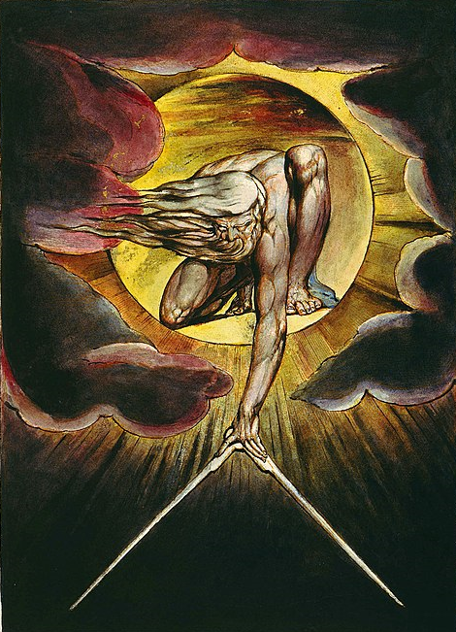
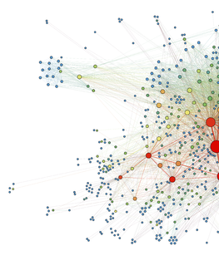
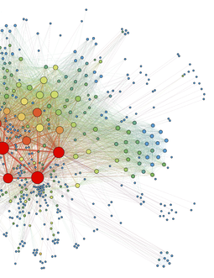
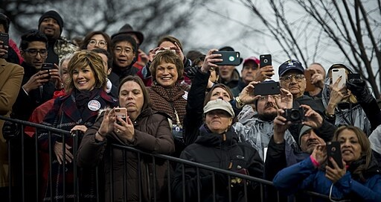
the book
rules
the record
authority
intermediation
control
universal bibliographic control
from the bottom up

Slide 4
People
The internet of things records and stores human memories
authors
publishers
cataloguers
etc.
readers
Information
books
metadata
online resources
reviews
etc.
The internet of metada provides access to human memory and culture

Slide 5
Medata tools
Tools for maintaining structured metadata must support:
Data processing
>> Let the machine do the work
Data granularity
>> Find a level of common interoperability
Entity-based cataloguing
>> Describe your own thing, relate it to others
Identity management
>> Process the names of things
Data provenance
>> Provide an audit trail

Slide 6
RDA tools for data processing
RDA provides two tools to support data processing:
Methods for processing data values
> Unstructured description (string)
> Structured description (string)
> Identifier (string)
> IRI (Internationalized URI)
Scenarios and structures for implementing data retrieval
> Linked open data
> Relational or object-oriented data
> Bibliographic/authority data
> Flat file data

Slide 7
Processing data values
Support User tasks:
Find, identify, select, obtain, explore
Fake? ☹
Unstructured description (string)
> Uncontrolled keyword indexing
Structured description (string)
> Controlled keyword indexing
> Collated and ordered browse lists
Trusted? ☺
Identifier (string)
> Direct access via local reference
IRI (Internationalized Resource Identifier = URI)
> Direct access via global reference

Slide 8
Implementation scenarios
> Linked open data
> Relational or object-oriented data
> Bibliographic/authority data
> Flat file data
Accommodate different (local) contexts, functions, traditions, systems
RDA entities and elements provide a consistent and coherent framework for description and access
Supports management of interoperability and data migration between implementations

Slide 9
RDA tools for data granularity
has related agent of work
RDA entities and elements are well-defined and organized in semantic hierarchies
has related person of work
has creator person of work
Support for machine reasoning and intelligence
has director person
has television director person
>> “This video is made by that person”

Slide 10
RDA tools for entity-based cataloguing
The same entity may be described for different (local) audiences and placed in multiple (local) contexts
1. Identify the class and instance of the entity
>> Boundaries may be physical or cultural
2. Describe the (instance of the) entity
>> Attribute elements are specific to an entity class
3. Relate the entity to other entities
>> Relationship elements are specific to the source and target entity classes

Slide 11
RDA tools for identity management
Nomen: an entity class for label strings
Supports the attributes and relationships of appellations (reference labels)
RDA accommodates three kinds of appellation:
Name or title of an entity
Assigned by an author, publisher, etc. (crowd)
Access point of an entity
Assigned by a cataloguer, etc. (intermediation)
Identifier of an entity
Assigned by an identifier system (media)

Slide 12
A future for authority control
authority
manager
is assigned
by agent
has authorized
access point
for entity
aap for
entity
entity
has nomen string
aap string
is derivation
of
name of
entity
has nomen string
name string
has name
of entity
has reference
source
manifestation
(statement)

Slide 13
RDA tools for data provenance
RDA treats a metadata statement or set of statements (“bibliographic record”) as a “metadata work” that can be described like any other work
Metadata about metadata = data provenance
This video
has related agent of work
that person
has source consulted
has author person
Fake or trusted? 😐
The cataloguer
person

Slide 14
A crowd of cataloguers
Data provenance might be generated automatically by the local application
RDA Registry provides free tools for embedding RDA entities, elements, and vocabularies in social media and other applications

Slide 15
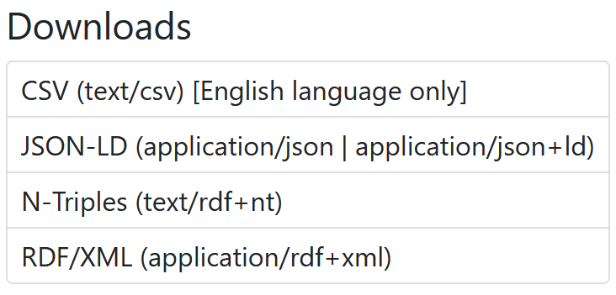
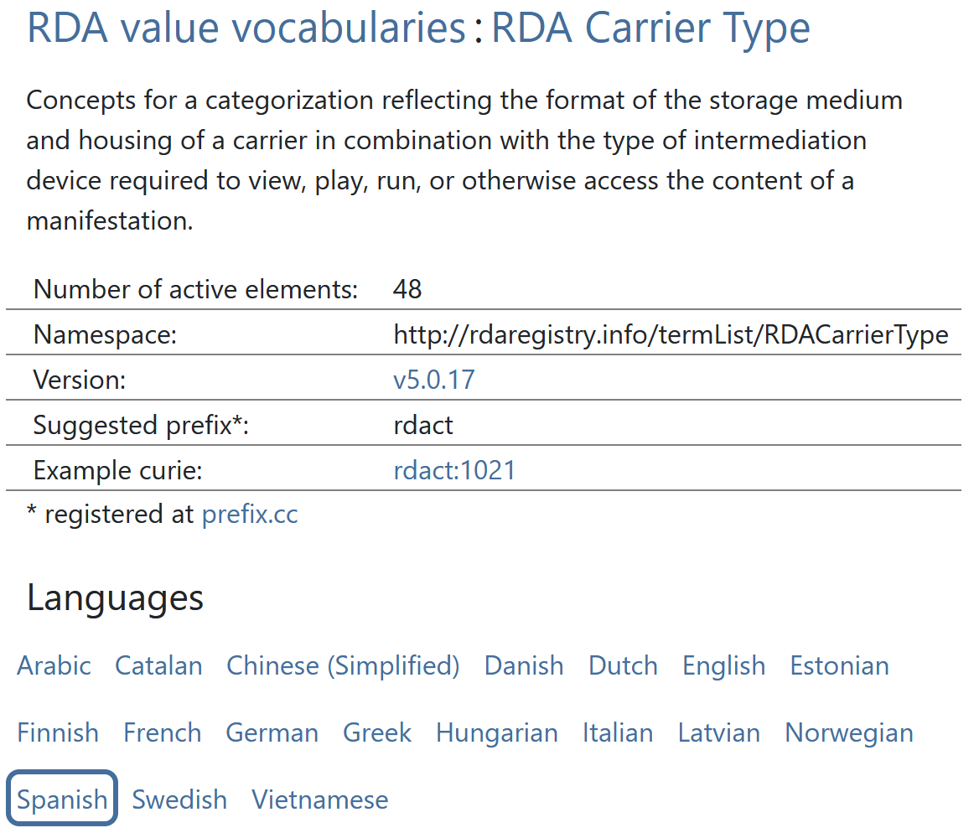
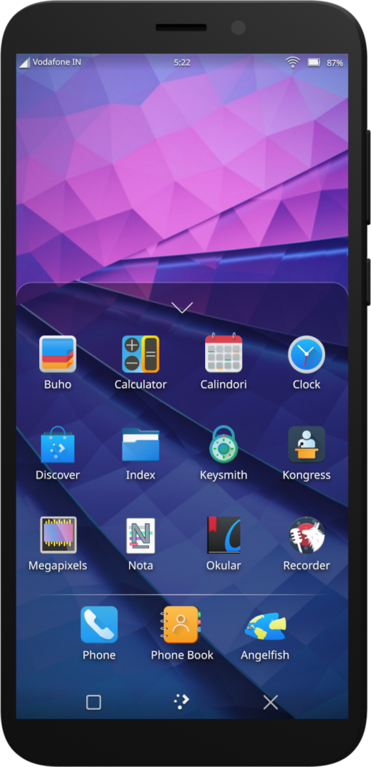
RDA in the crowd
My
mean
metadata
machine

Slide 16
Conclusion
The current information age is characterized by the creation of huge quantities of recorded human memory
Some of it is worth preserving for future generations as “cultural heritage”
RDA provides the tools to describe and access information resources at local and global levels
These tools can be embedded within the internet of things for collaborative management of cataloguing
Metadata
of the crowd, by the crowd, and for the crowd

Slide 17
Thank you!
More like this:
http://www.gordondunsire.com/publications.htm
Image credits:
The ancient of days. William Blake
DOD supports 58th Presidential Inauguration, inaugural parade. Staff Sgt. Marianique Santos
Social network visualization. Martin Grandjean
Crowd at Knebworth House – 1976. Sérgio Valle Duarte
Plasma Mobile running on PinePhone. KDE

