Slide 1
RDA Update 2020
Gordon Dunsire, RDA Technical Team Liaison Officer
Presented at RDA Day, CILIP MDG online conference
11 September 2020

Slide 2
Overview
A brief introduction to new content in beta RDA Toolkit (Sep 2020, next week, anything can happen)
Guidance
Entity boundaries
Well-formed RDA
IFLA LRM mappings
Community resources
Internationalization
Policy statements
Translations

Slide 3
Notes:
And this is the English translation.

Slide 5
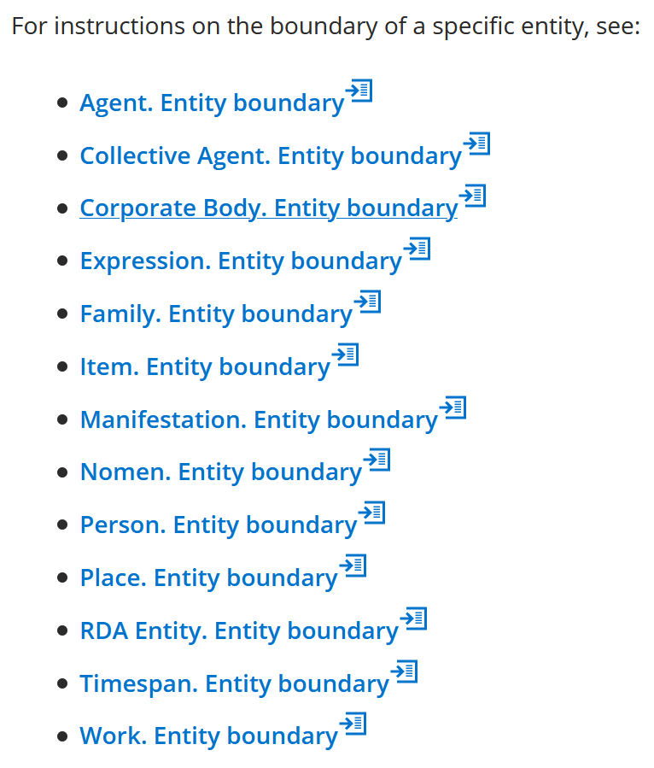

Slide 7
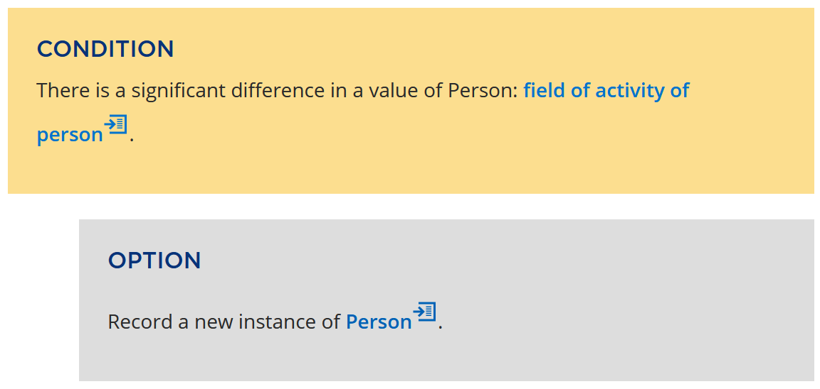

Slide 10
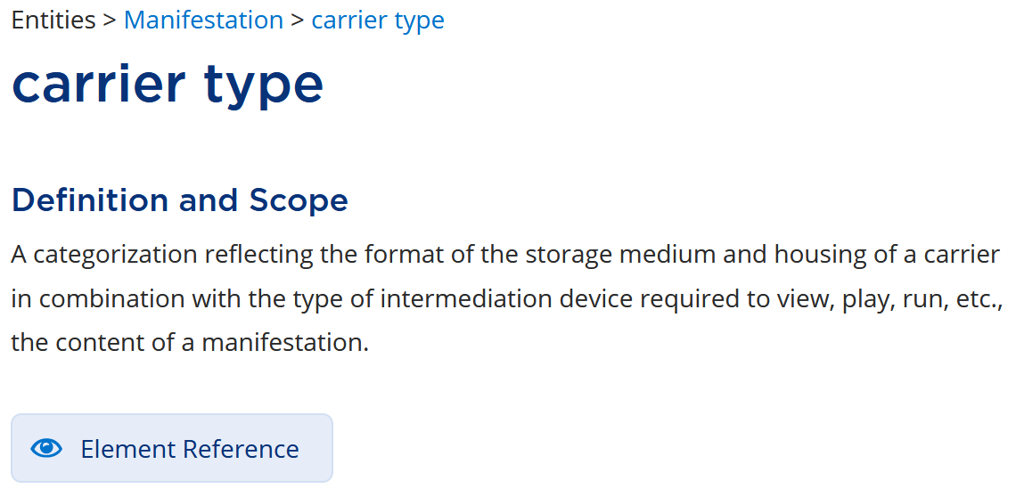

Slide 11
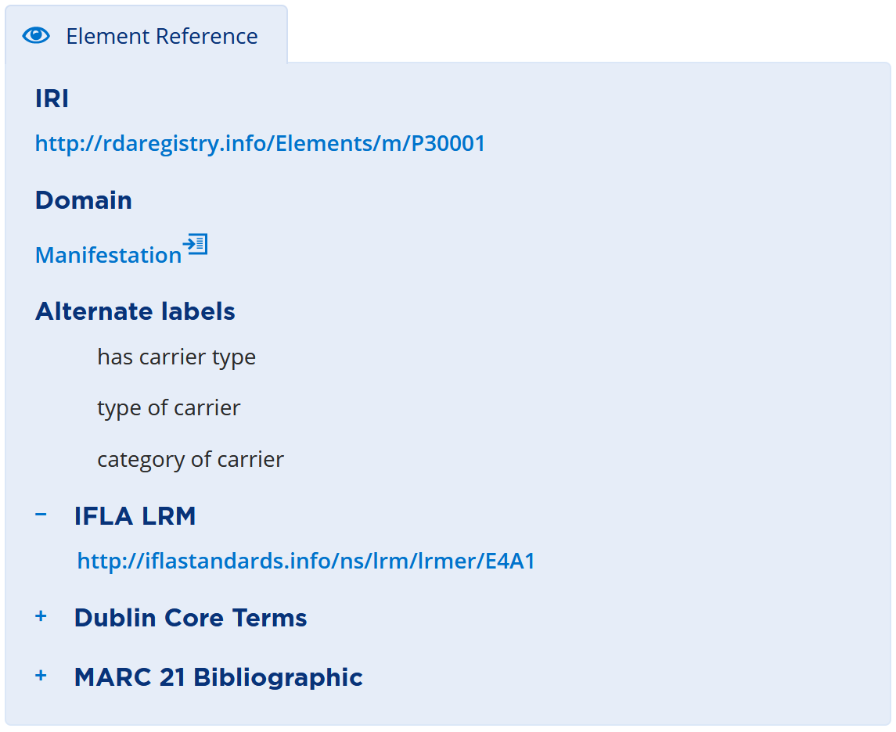

Slide 13
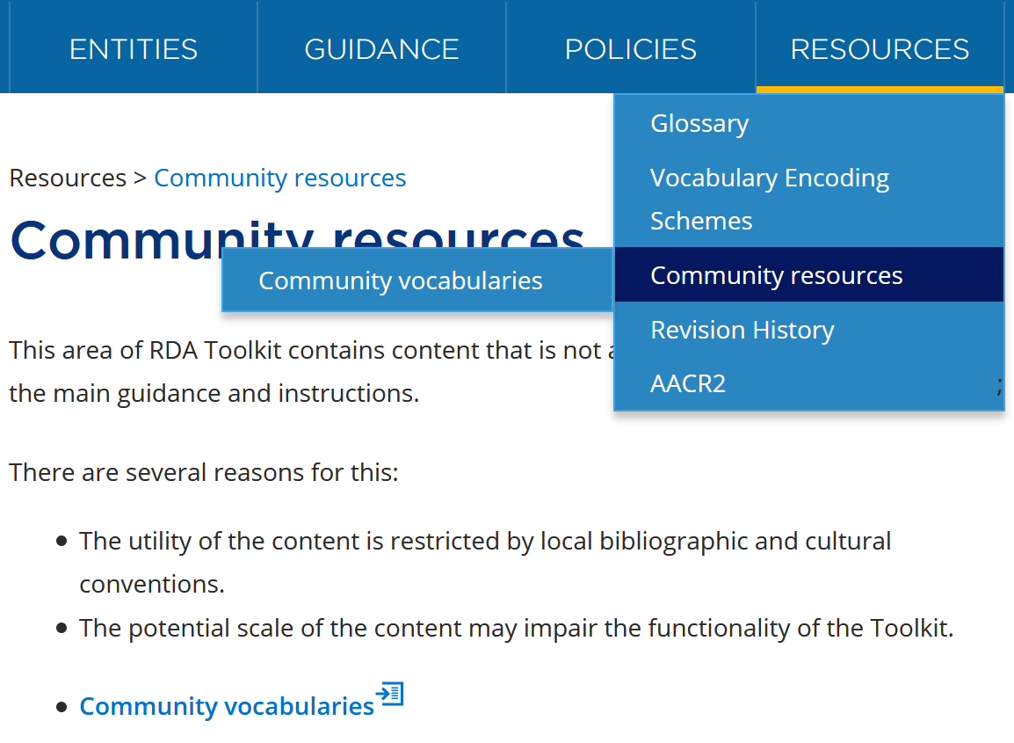

Slide 16
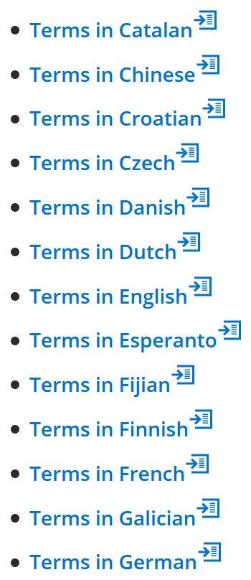
Under
(international)
construction

Slide 18
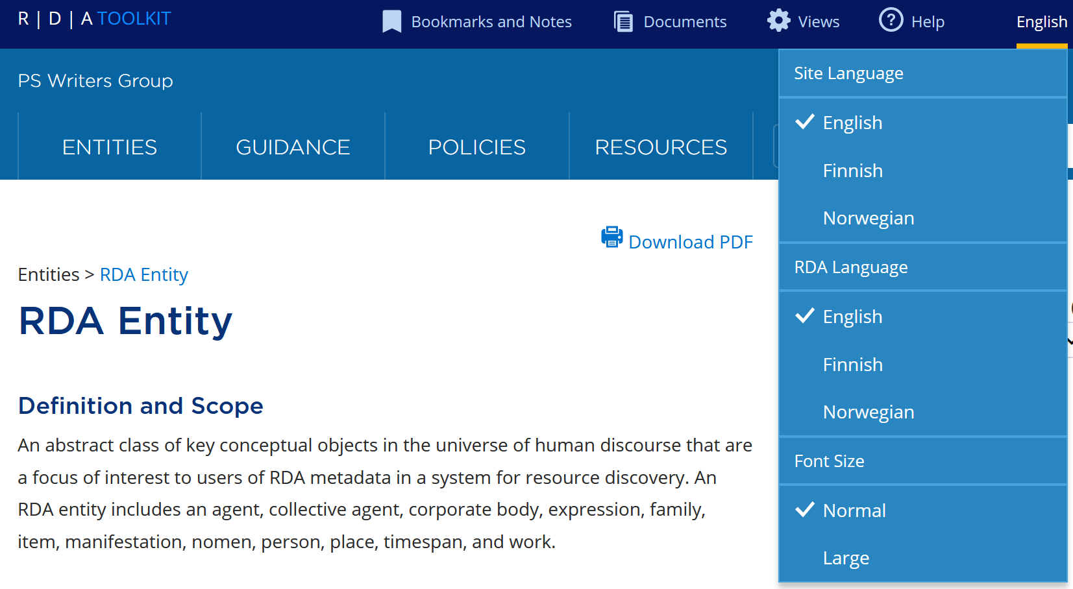

Slide 19
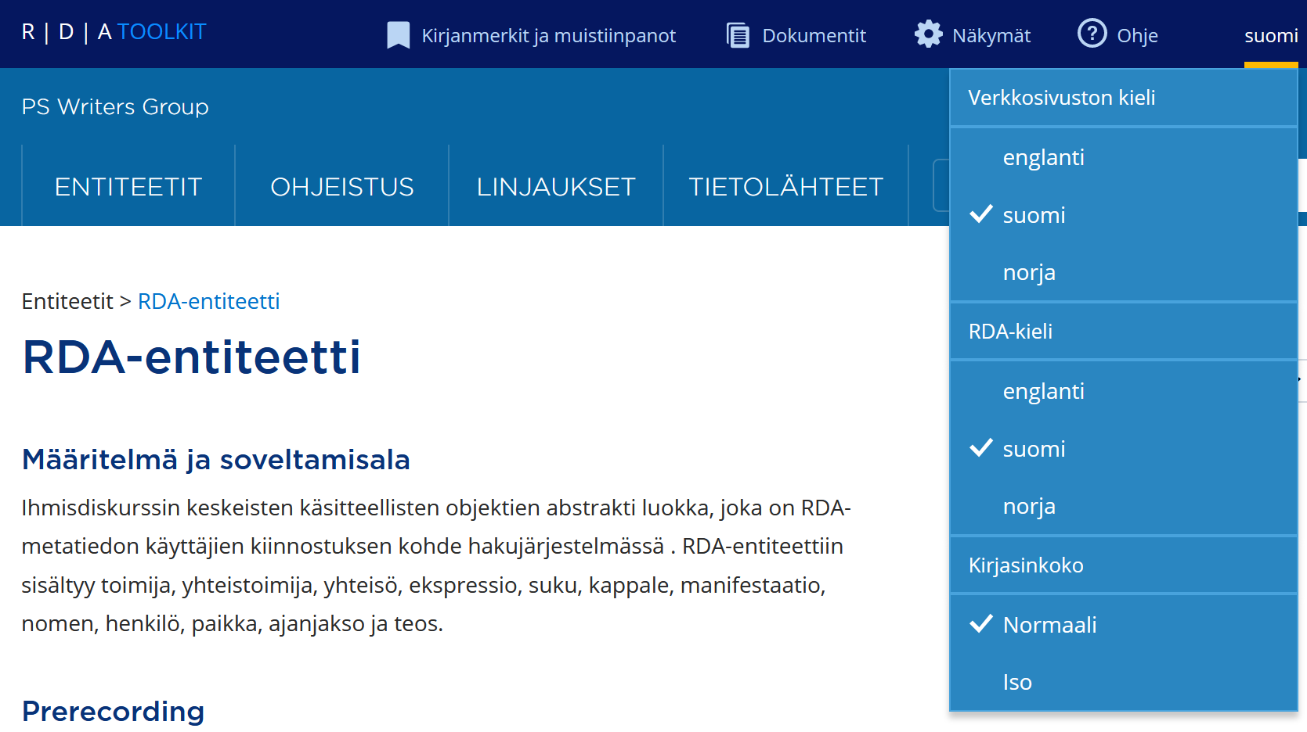

Slide 20
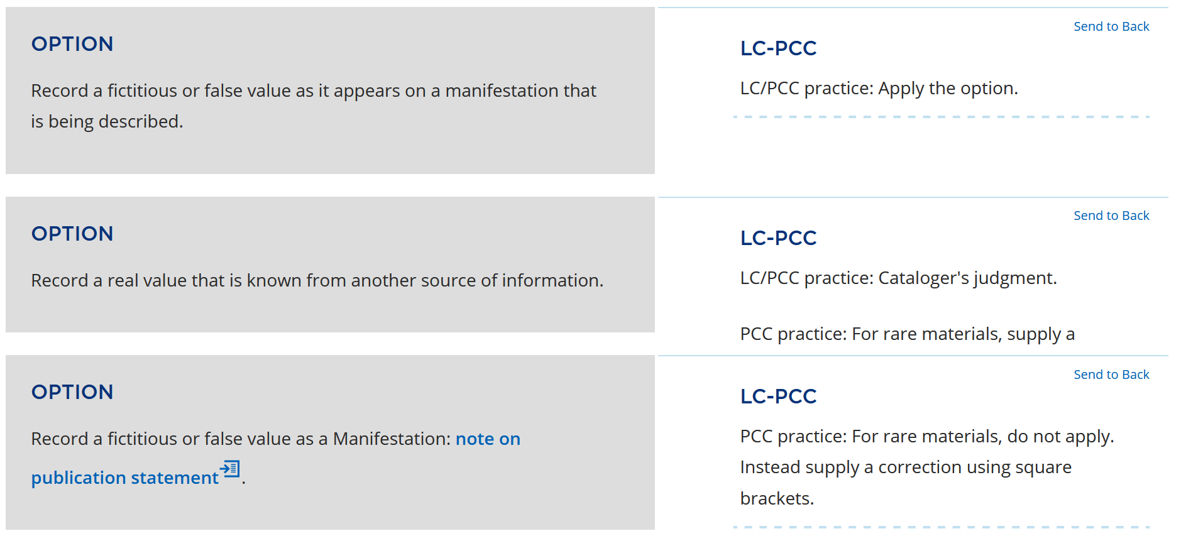

Slide 21
Beta is beta …
… until mid-December
Do not panic ☺
Current Toolkit will remain available

Slide 22
Thank you!
RDA Steering Committee
http://www.rda-rsc.org/
RDA presentations
http://www.rda-rsc.org/node/560
RDA Toolkit
https://www.rdatoolkit.org/

