Slide 1
RSC Strategy and RDA Internationalization
Gordon Dunsire, Chair, RDA Steering Committee
Presented at the Cervathon, 14 April 2016, Madrid, Spain

Slide 2
RDA strategy
3 targets:
International communities
Cultural heritage communities
Linked data communities
RDA is a package of data elements, guidelines, and instructions for creating library and cultural heritage resource metadata that are well-formed according to international models for user-focussed linked data applications.

Slide 3
RDA data
RDA Toolkit provides the user-focussed elements, guidelines, and instructions.
RDA Registry provides the infrastructure for well-formed, linked, RDA data applications.
Open Metadata Registry provides the linked data representation of RDA Reference.
Notes:
The RDA data ecosystem is summed up in this sentence introducing the RDA Board’s announcement of RDA’s strategic directions.
The RDA package is delivered by an infrastructure of two interacting services.
The human-facing components, including the guidelines and instructions, are the Toolkit.
The data-facing components are contained in the Registry.
Applying the data capture and storage techniques in RDA Toolkit to the data architecture in the RDA Registry produces well-formed data for RDA applications.

Slide 4
RDA data infrastructure
RDA Reference:
Elements, attributes, relationships, values
Open Metadata Registry (RDF)
RDA Registry
RDA Toolkit
Notes:
The RDA data ecosystem is summed up in this sentence introducing the RDA Board’s announcement of RDA’s strategic directions.
The RDA package is delivered by an infrastructure of two interacting services.
The human-facing components, including the guidelines and instructions, are the Toolkit.
The data-facing components are contained in the Registry.
Applying the data capture and storage techniques in RDA Toolkit to the data architecture in the RDA Registry produces well-formed data for RDA applications.

Slide 5
Progress on RDA governance
November 6, 2015: Change of name
Committee of Principals
For RDA
(CoP)
RDA Board
Joint Steering Committee
For Development of RDA
(JSC)
RDA
Steering Committee
(RSC)
http://www.rda-rsc.org/
Notes:
The Committee of Principals and Joint Steering Committee changed names in November 2015.

Slide 6
Notes:
These changes have been applied to the Steering Committee’s website.
The website now accommodates web pages for the RDA Board.

Slide 7
RDA Steering Committee
North America
Europe
Asia
Chair of RDA Board
Latin America
& the Caribbean
Africa
Oceania
ALA Publishing
Chair
Technical Team Liaison
Secretary
Translations Team Liaison
Examples Editor
Wider Community Engagement
Notes:
This is the final structure of the RSC.
Members marked in blue are already in place.
Members marked in gray have clear transition paths.
The other members are in preliminary stages of transition planning.

Slide 8
RDA Steering Committee - Europe
JSC 2015
Edinburgh
RSC 2016
Frankfurt
CILIP
British Library
UK
Deutsche Nationalbibliothek
Europe
Notes:
Changes to the structure of the RDA Steering Committee have already been made.
The representation of the UK’s Chartered Institute of Library and Information Professionals (CILIP) and of the British Library were merged to form a temporary United Kingdom community prior to the JSC meeting in Edinburgh in November 2015.
Transition to a Europe regional community will involve an additional merger with the DNB representation. This may take place on or before the next RSC meeting, scheduled to be held in Frankfurt, Germany, in November 2016.

Slide 9
RDA Working Groups
Standing
Working Groups→
Technical
Translations
Aggregates
Music
←Task and Finish
Working Groups
Archives
Places
Capitalization Instructions
Rare materials
Fictitious Entities
RDA/ONIX Framework
Relationship Designators
Notes:
Working groups marked in green are active.
A new Rare Materials Working Group is about to be implemented.
This has taken priority over the new Archives Working Group, which is in the preliminary stages of planning.

Slide 10
Liaison with external groups
RSC has lightweight protocols with
FRBR Review Group
ISBD Review Group
ISSN International Centre
LC NDMSO
Notes:
Changes to the structure of the RDA Steering Committee have already been made.
The representation of the UK’s Chartered Institute of Library and Information Professionals (CILIP) and of the British Library were merged to form a temporary United Kingdom community prior to the JSC meeting in Edinburgh in November 2015.
Transition to a Europe regional community will involve an additional merger with the DNB representation. This may take place on or before the next RSC meeting, scheduled to be held in Frankfurt, Germany, in November 2016.

Slide 11
Feedback from users
Hackathons: Jane-athons
***Cervathon***
Clarity
Consistency
Simplicity
RSC
RDA
Translation teams

Slide 12
Contexts (next 2-3 years)
Governance transition
FRBR Library Reference Model
International standards (IFLA, ISSN, …)
Toolkit review and re-organization

Slide 13
Some specific activities
Translations
Multi-lingual RDA data
Local refinement of elements and values
Local policies and practices

Slide 14
Translations
RDA
Translations Policy
In process (RDA Toolkit):
Finnish
Italian
Translations in
RDA Registry:
German
French
Spanish
Chinese
In process (RDA Reference):
Arabic
Dutch
Swedish
Chinese

Slide 15
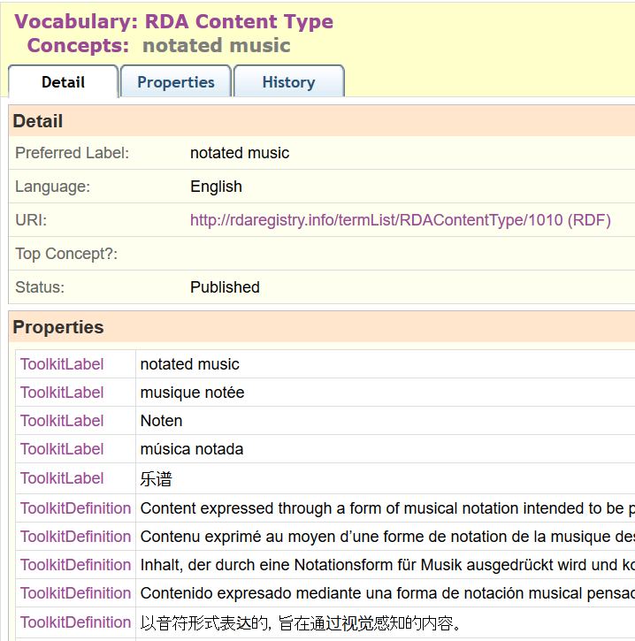
Semantic
Web

Slide 16
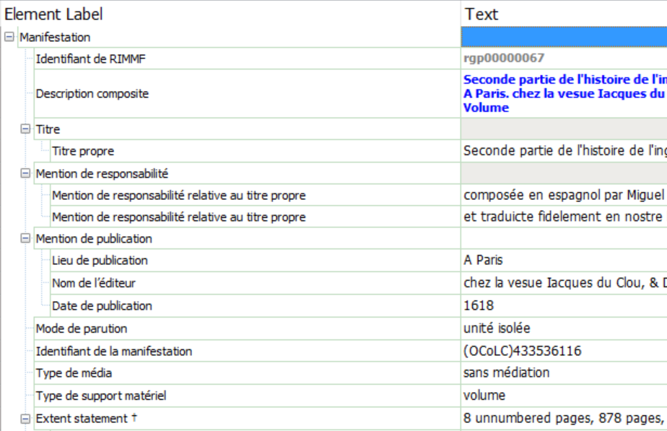
Multi-lingual data
Cervathon – RIMMF!

Slide 17
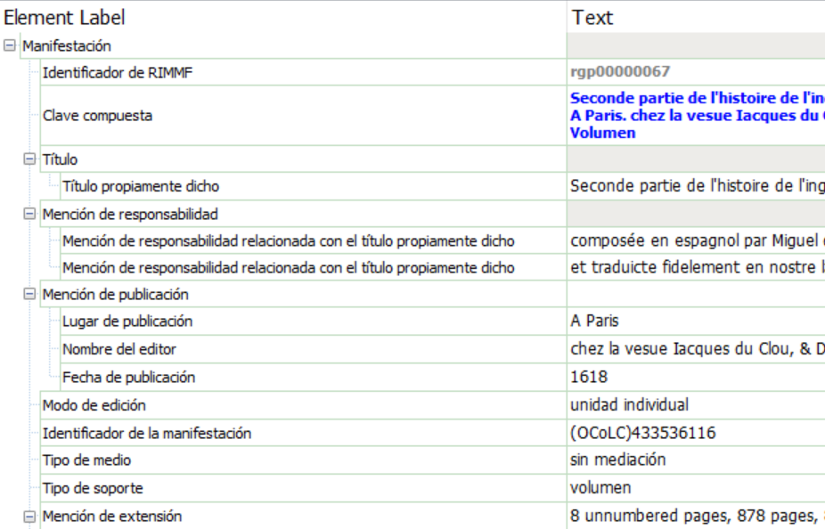
Multi-lingual data
Cervathon – RIMMF!
Language of interface = Spanish
Language of manifestation = French

Slide 18
Multi-lingual data
Cervathon – RIMMF!
Language of interface = Spanish
Language of value = Spanish

Slide 19
Multi-lingual data
Cervathon – RIMMF!
Language of interface = Spanish
Language of value = English

Slide 20
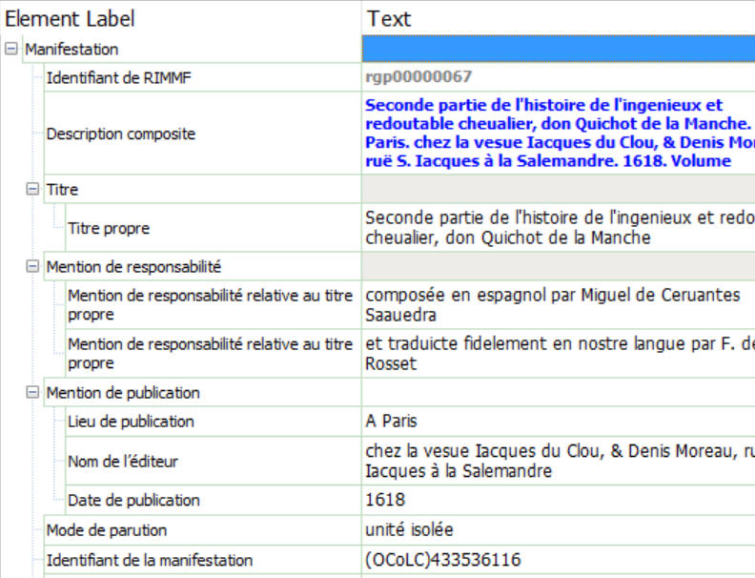
Multi-lingual data
Cervathon – RIMMF!
Same URIs, translated labels
Language of interface = French
Language of value = French

Slide 21
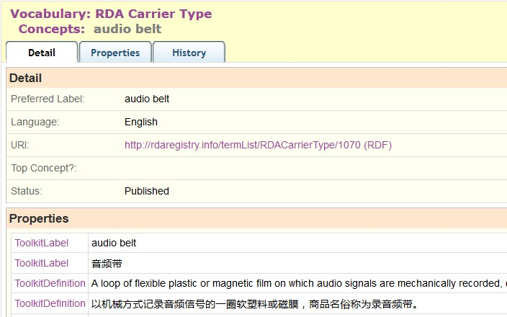
Local
refinement
“audio belt”: refinement to Carrier type
via RDA/ONIX Framework
Notes:
RDA is being developed to support refinements and extensions to RDA elements and vocabularies for local applications.
An example is “audio belt”, proposed by the Library of Congress as a new RDA Carrier type.
This was implemented as a local RDA refinement of a basic resource category in the RDA/ONIX Framework ontology.
The new type is included in the vocabulary, and the nature of the refinement is given in a machine-readable map in the RDA Registry.

Slide 22
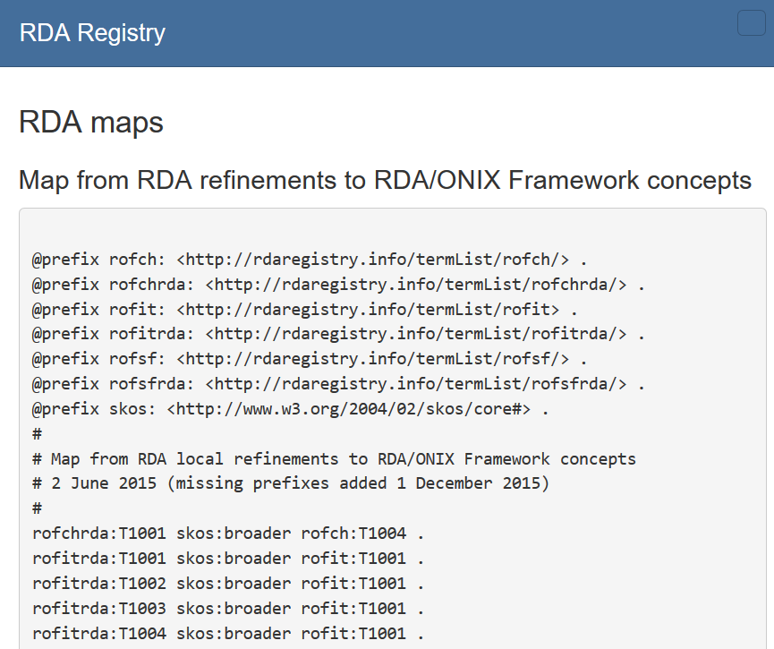
Maps for machines

Slide 23
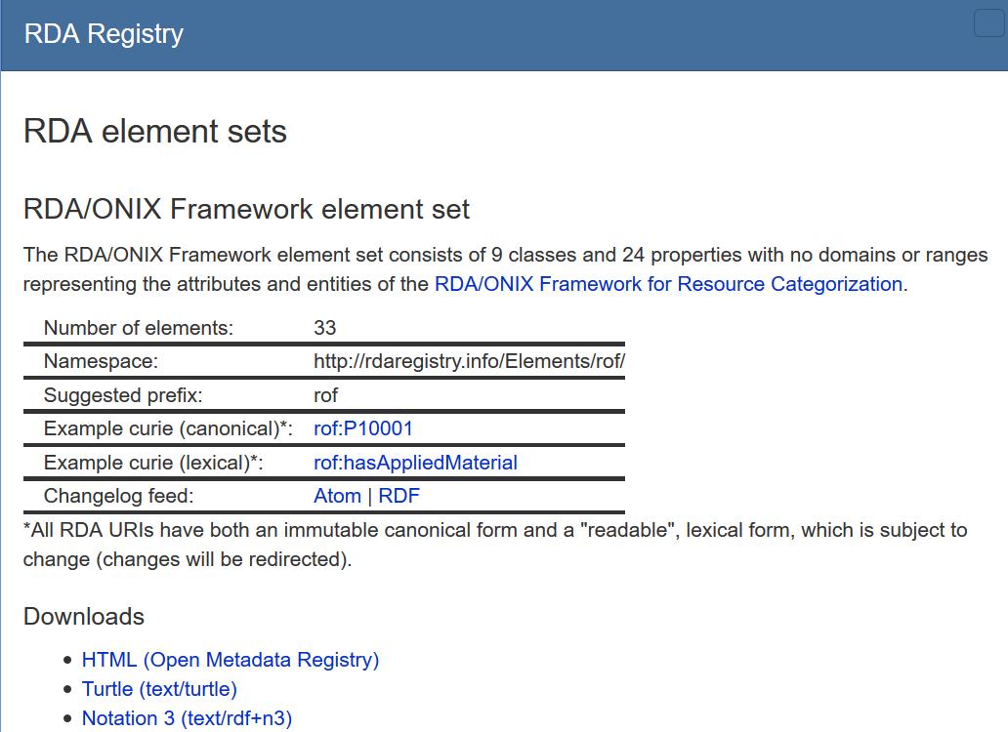

Slide 24
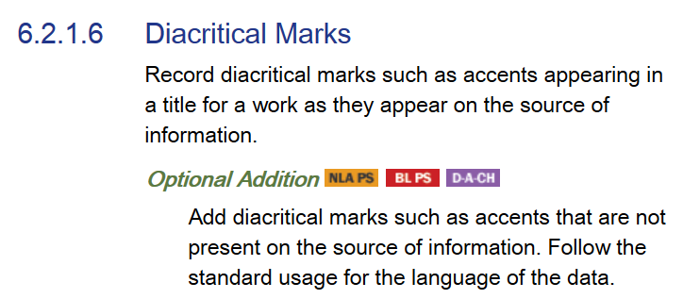
Local policies
National Library of Australia
Policy Statement
British Library
Policy Statement
Germany, Austria,
Switzerland
Notes:
RDA is being developed to support refinements and extensions to RDA elements and vocabularies for local applications.
An example is “audio belt”, proposed by the Library of Congress as a new RDA Carrier type.
This was implemented as a local RDA refinement of a basic resource category in the RDA/ONIX Framework ontology.
The new type is included in the vocabulary, and the nature of the refinement is given in a machine-readable map in the RDA Registry.

Slide 25
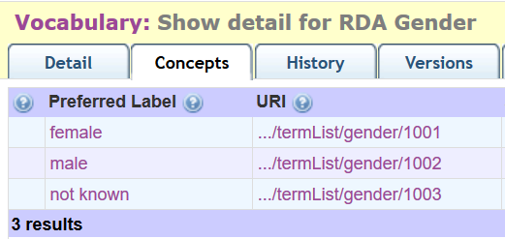
Local vocabularies
Vocabulary removed
from “global” RDA
becomes a “local” vocabulary
Notes:
RDA is being developed to support refinements and extensions to RDA elements and vocabularies for local applications.
An example is “audio belt”, proposed by the Library of Congress as a new RDA Carrier type.
This was implemented as a local RDA refinement of a basic resource category in the RDA/ONIX Framework ontology.
The new type is included in the vocabulary, and the nature of the refinement is given in a machine-readable map in the RDA Registry.

Slide 26
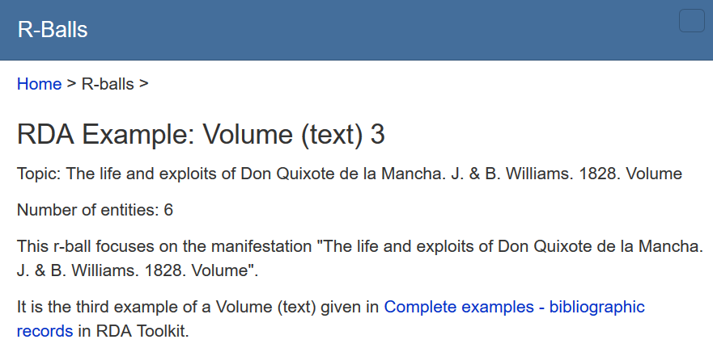
Global linking

Slide 27
Engagement – get involved!
Membership of RSC Working Groups
RDA Development Forum
Community representation on RDA Steering Committee
Community representation on RDA Board
Email and issue discussion on RDA-L and RDA Vocabularies Github project
Cervathons!

Slide 28
Thank you
rscchair@rdatoolkit.org
RSC website
http://www.rda-rsc.org/
RDA Toolkit
http://www.rdatoolkit.org/
RDA Registry
http://www.rdaregistry.info/
RDA data, Jane-athons, etc.
http://www.rballs.info/

