Slide 1
The new version of RDA: structure, key concepts and content
Gordon Dunsire, RDA Technical Team Liaison Officer
Presented at IFLA Satellite meeting on RDA, Aristotle University of Thessaloniki, 21 August, 2019

Slide 2
Library Reference Model
RDA is an implementation of the LRM
RDA is an extension of the LRM
All RDA entities and elements are equivalent or narrower sub-types of LRM entities, relationships, and attributes.
Corporate Body and Family are sub-types of Collective Agent
RDA entities are encapsulated under RDA Entity
RDA Entity is a sub-type of LRM Res

Slide 3
Structure
All RDA elements are treated equally
No “relationship designators’ in appendices
Instructions for recording an entity or element are grouped under the entity or element
Each has its own “page”
Element pages are grouped in entity “chapters”
General guidance on special topics is provided separately
Modular structure supports context

Slide 5
Recording methods
Four distinct kinds of data
1. Unstructured description: keyword indexes
Transcriptions, notes; flat-file applications
2. Structured description: browse indexes, parsing
Derived, compound values; bib/authority applications
3. Identifier: direct indexes
Local scope; relational database applications
4. IRI (URI): Semantic web
Global scope; linked open data applications

Slide 6
Transcription
Context: How a manifestation describes itself
Principle of representation
Basic transcription is optimized for machine intermediation
Optical character recognition software
Normalized transcription preserves the current RDA approach
Other transcription rules may be applied

Slide 7
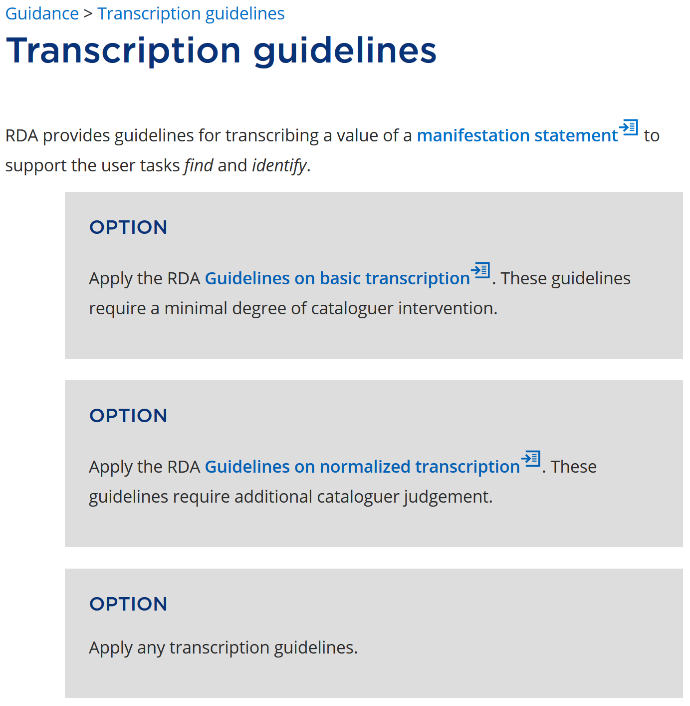

Slide 8
Manifestation statements
LRM attribute that accommodates the principle of representation
RDA provides a set of sub-types that have an approximate alignment with ISBD
e.g. manifestation edition statement
Unstructured description: the value is obtained by direct transcription, with or without transliteration

Slide 9
Appellations and Nomen
Nomen entity treats an appellation as a thing that can be described separately
“Name” authority control
An appellation is a string that references an entity
Name/title, access point, identifier
RDA provides specific elements for appellations
e.g. title of work; access point for person; identifier for place

Slide 10
Appellations and recording methods
The string value of a relationship element must be an appellation of the related entity
Related person of work: “Gordon Dunsire”
“Dunsire, Gordon”
“nb2001072552”
Appellation element | Value string | Recording method
Name of person | “Gordon Dunsire” | Unstructured description
Access point for person | “Dunsire, Gordon” | Structured description
Identifier for person | “nb2001072552” | Identifier

Slide 11
Data provenance
Metadata about metadata
Who created the metadata?
When? Using what standards? etc.
RDA treats a metadata description set (one or more statements) as a Work
The work is described using RDA
Provenance is optional
But is essential in the context of ‘fake news’
Fake metadata ☹

Slide 12
Options …
RDA does not assume that all, or most, Toolkit users will make the same choices
What entity to use in a hierarchy? What element to use? What relationship element to use in a hierarchy?
Record the first value, any value, or all values?
Etc.

Slide 13
Choices
Optional instructions are explicitly presented, often associated with conditions that provide a context
Guidance and instructions indicate that entity and element hierarchies and appropriate recording methods provide choices
All levels of choice have active links and citation numbers

Slide 14
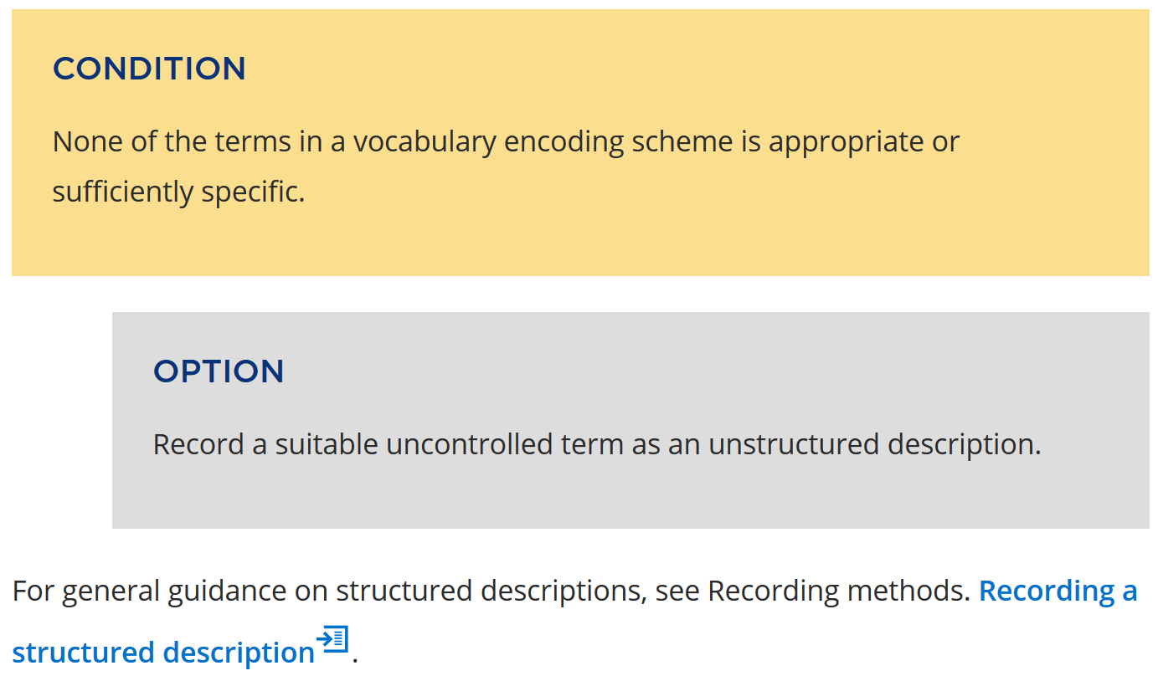
Boilerplate: consistent phrasing

Slide 15
Restrictions
Well-formed RDA metadata must conform to the semantics of the LRM and RDA
Coherent description: FRBR “primary” elements and cardinality
Minimum description: At least one appellation element

Slide 17
Consistency
Semantic conformance allows RDA metadata to interoperate at ‘lowest common denominator” global level
Via entity and element hierarchies
Interoperability of metadata values requires conformance with local choices for strings
Via “authority” processes

Slide 18
Application
The new RDA Toolkit is ready for:
The cloud of metadata processing
Smart metadata
Slightly dumber metadata
Multilingual metadata
Local applications in a global network
Individual, institutional, national, and international choice

Slide 19
Thank you!
techo@rdatoolkit.org

